Slide 1
CALGARY ITALIAN SCHOOL

Slide 2
45 YEARS OF HISTORY
The Calgary Italian School was created with a vision – the vision of community members who believed so strongly in the importance of educating our young people about their rich cultural heritage that they were willing to create something from nothing. The following outlines the highlights of the school’s history.

Slide 3
THE BEGINNING
1973 - On the initiative of Consul Dottor Giovanni Germano, a committee of
community leaders is formed to discuss the possibility of opening a school in Calgary. With the support of the Calgary Italian Club initial meetings are held and it is when Alberto Romano presents the committee with a list of 60 interested students’ names that the project gains momentum. Serafino Scarpino succeeds in finding 120 more students and it is clear that the dream is about to become a reality. Early committee members include: Alberto Romano, Serafino Scarpino, Jimmy Barbaro, Joe Commissotti, Norma Massolin, Cosma Ius, Rodolfo Pacione, Gary Cioni, Eda De Santis, Vice-Consul Dott. Sandro Silenzi and Vice-Principal Pasqualotto of St. Mary’s High School.

Slide 4
THE FIRST YEARS 1974-1975
By the first day of classes on January 5, 1974, student enrollment is up to 200. The Consolato Generale d’Italia in Vancouver makes an initial contribution of $ 1 000. Classes are held on two separate campuses: one at St. Alphonsus and the other at St. Michael’s.
In 1976 classes move to St. Mary’s. Finally, in 1978 the school moves to its present home, the Calgary Italian Club.

Slide 6
New Initiatives 1981- 1998
1981 - A curriculum for Italian 10, 20 and 30 is developed jointly with the Dante Alighieri School in Edmonton and the provincial government, and the three programs receive official accreditation
1985 - A $ 500 scholarship to promote the study of Italian language and culture is established, to be awarded to the student with the highest grade in Italian 30.
1987- In collaboration with the Calgary Italian Club, the Italian-Canadian Folkdancers of Calgary is born. Most of the original dancers come from the classrooms of the Calgary Italian School.
1988 - A scholarship for study at the Università per gli Stranieri in Perugia, Italy, is established. Alberto Romano, after 14 years of dedicated service, resigns as President. Domenico Rossi takes on the role.
1997 - Teaching is enhanced by the acquisition of a variety of multimedia resources.
1998 - The Calgary Italian School develops its very own curriculum in compliance with provincial directives.

Slide 7
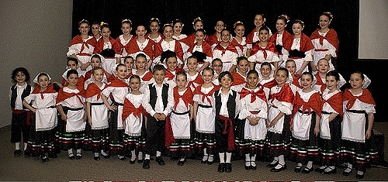
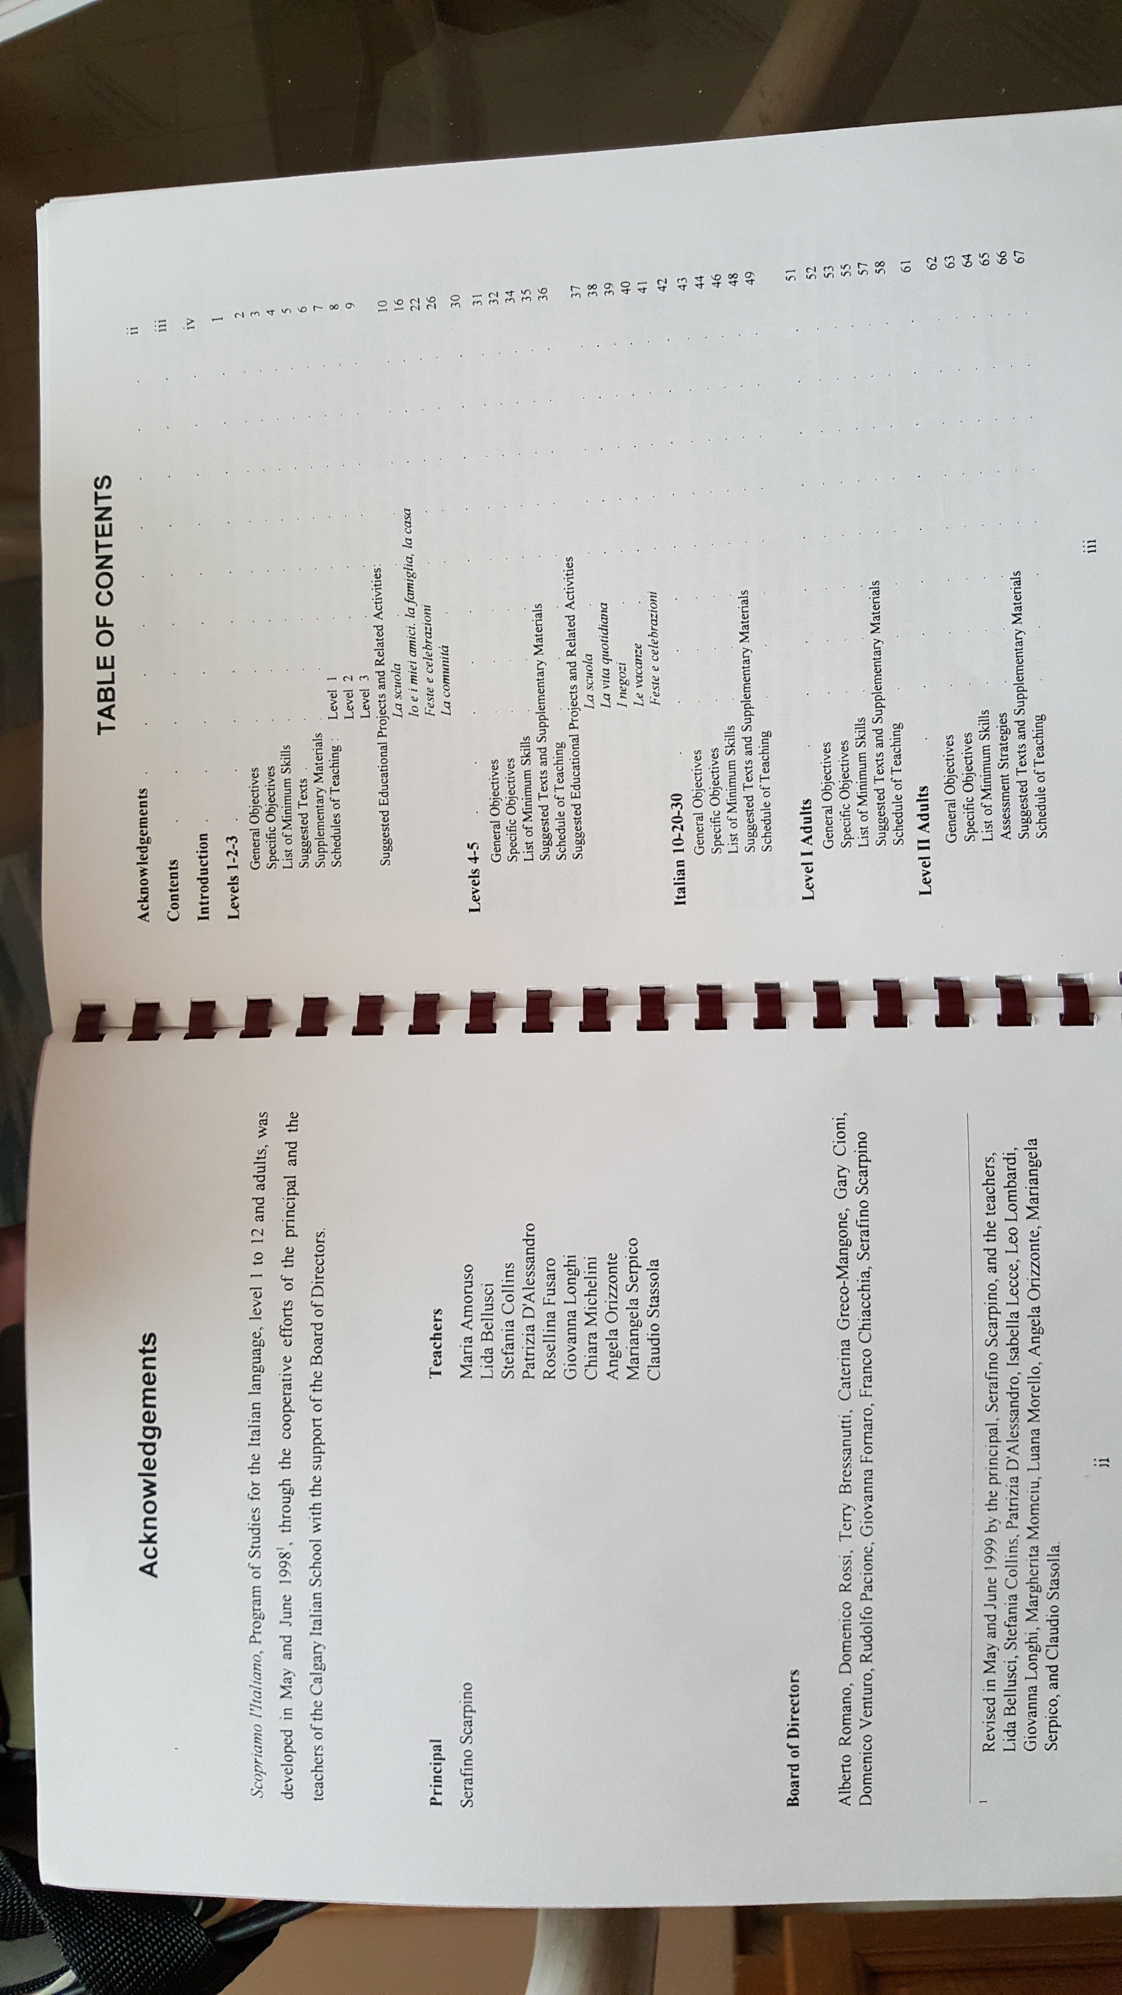
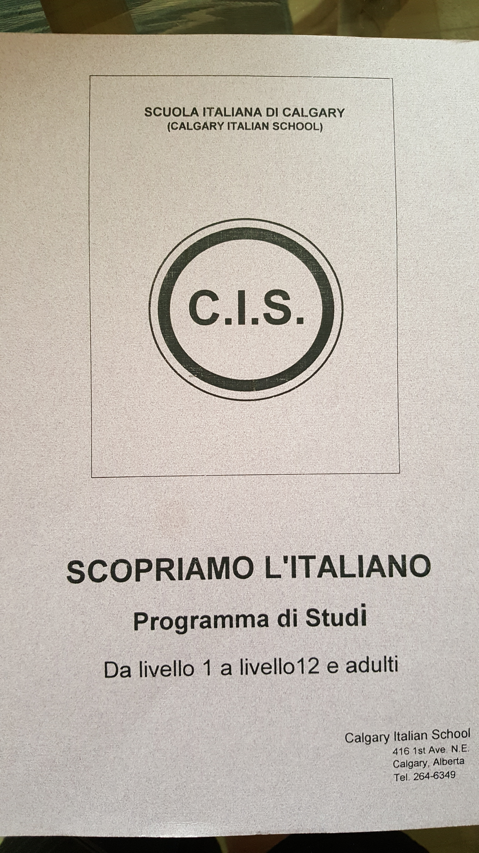

Slide 8
25 years old but still growing
.
.
1999 - The Calgary Italian school proudly celebrates 25 years of success in fostering the study of Italian language and culture in the Calgary community.
2004 - Thanks to the financial support of several Italian associations, the Calgary Italian School renovates its premises by adding six new classrooms for its growing school population.
2006 – The Calgary Italian School is instrumental in the offering of the ILC (Italian Language and Culture Program) in two elementary schools with the Calgary Catholic School Board beginning September 2006. Domenico Rossi, after 18 years of dedicated service, resigns as president. Caterina Greco-Mangone takes on the role.
2009 - The Calgary Italian School teaching staff revises the school Program of Study Scopriamo l’italiano to include student outcomes and classroom activities in line with Alberta Education Italian Language and Culture 12-year Program and the Common European Framework of Reference for Languages.

Slide 9
2010 - 2018
2010 - The newly revised “Scopriamo l’italiano” program of study is implemented in all courses.
2010 - 2014 The Calgary Italian School undergoes a second turn of renovations that bring major improvements to classrooms and common areas.
2015 – 2016 The Calgary Italian School yearbook is published for the first time and distributed at the end of the school year.
2016 – 2018 The Calgary Italian School makes a substantial investment in technology for teaching and learning.

Slide 10
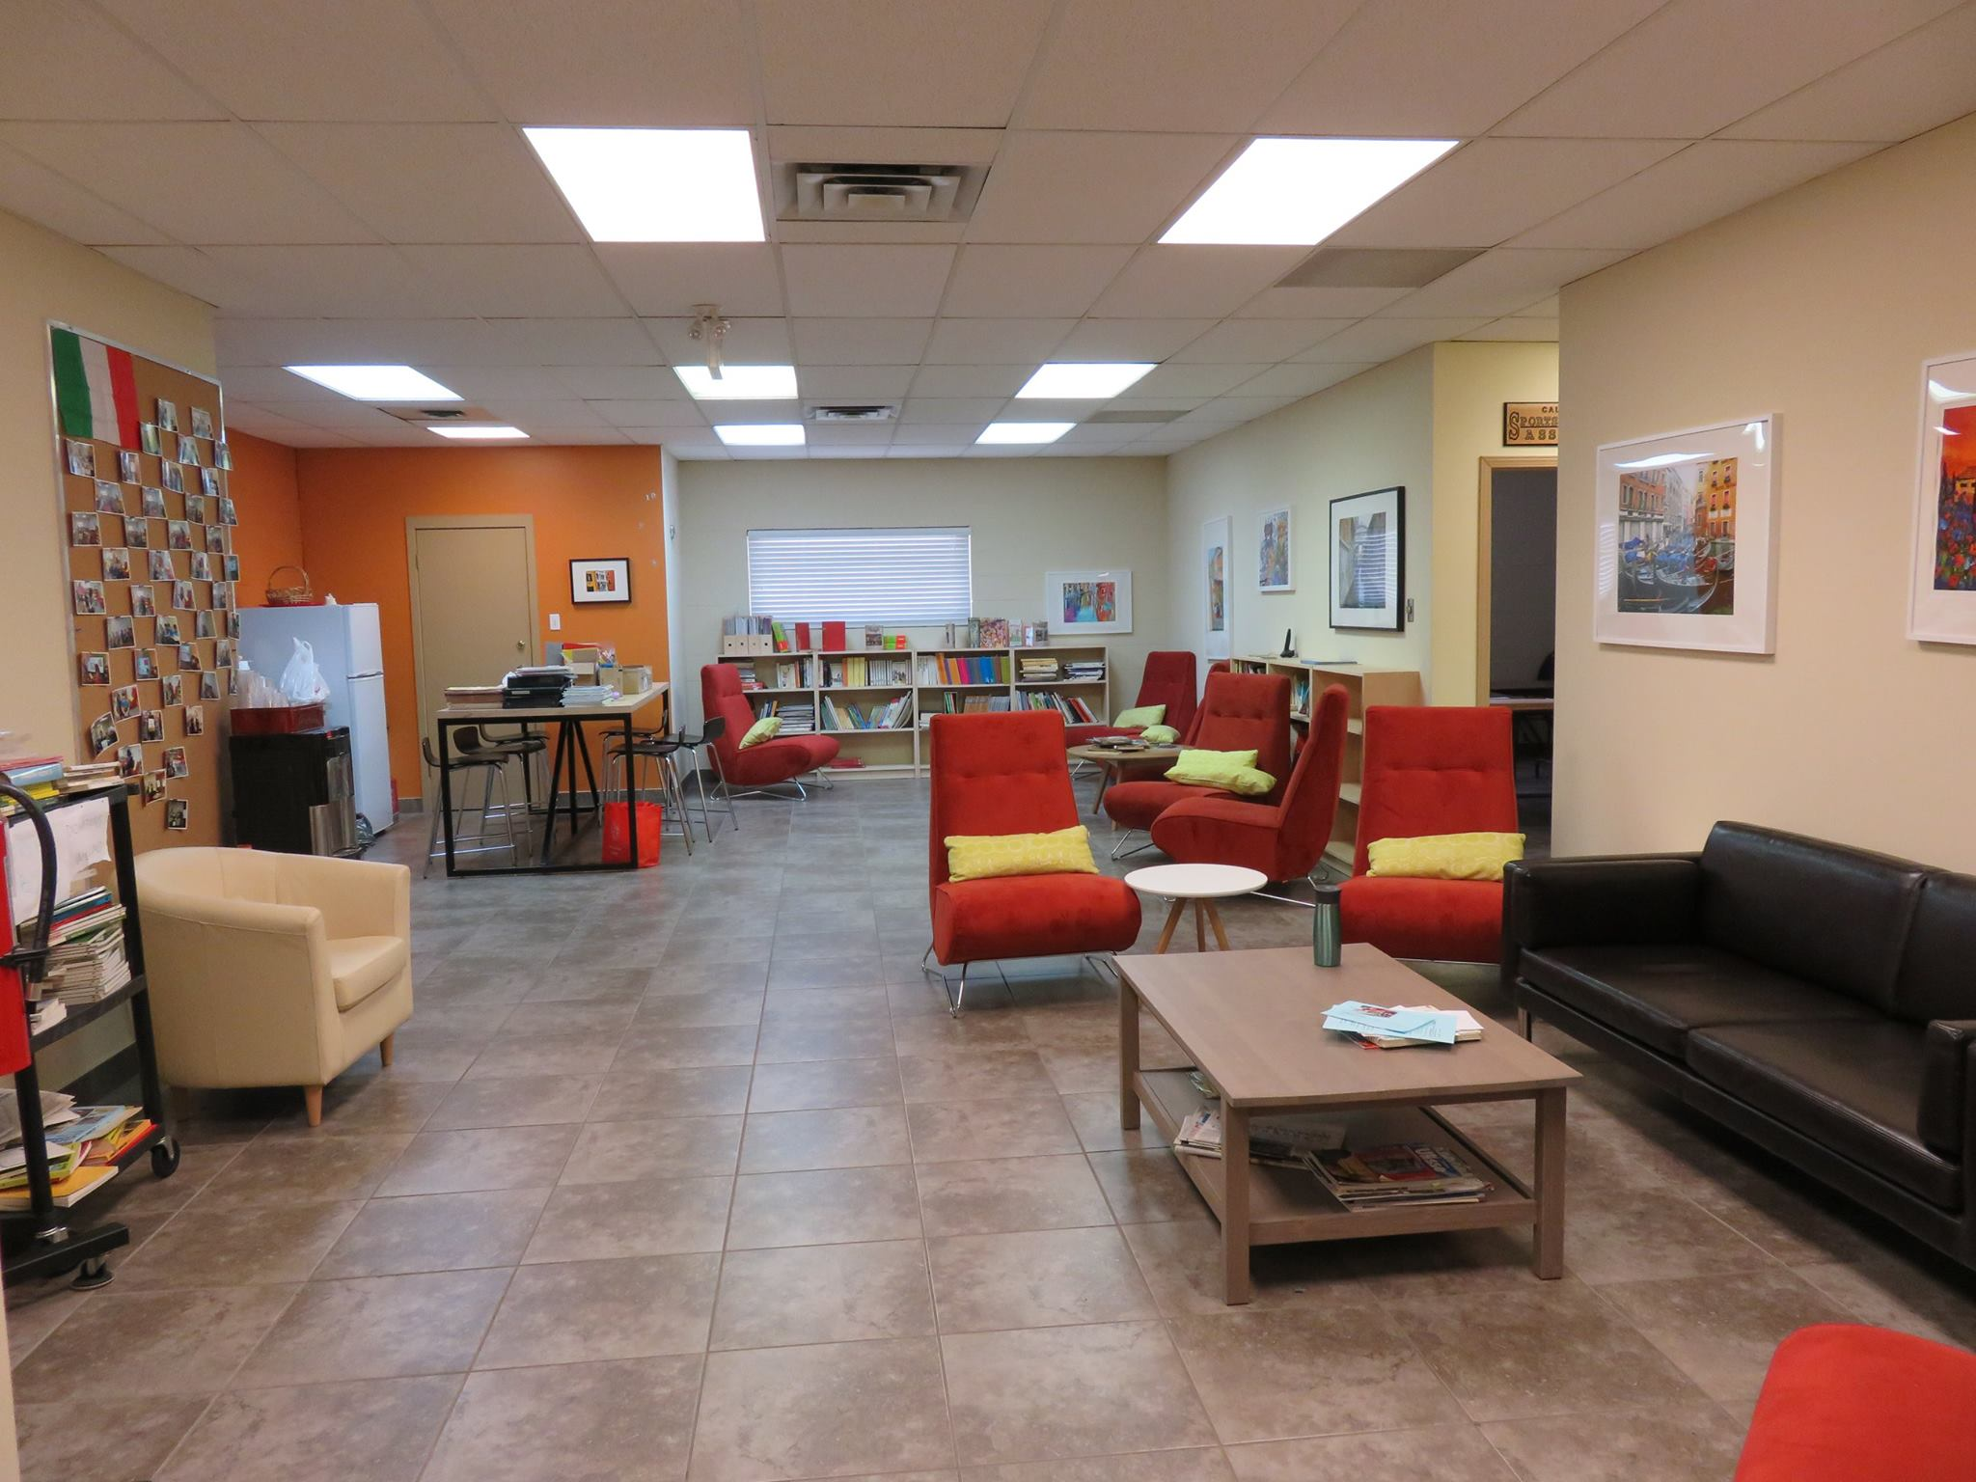

Slide 11
