Slide 1
SAHLA 2024 Languages Education Symposium
Saturday June 22, 2024

Slide 2
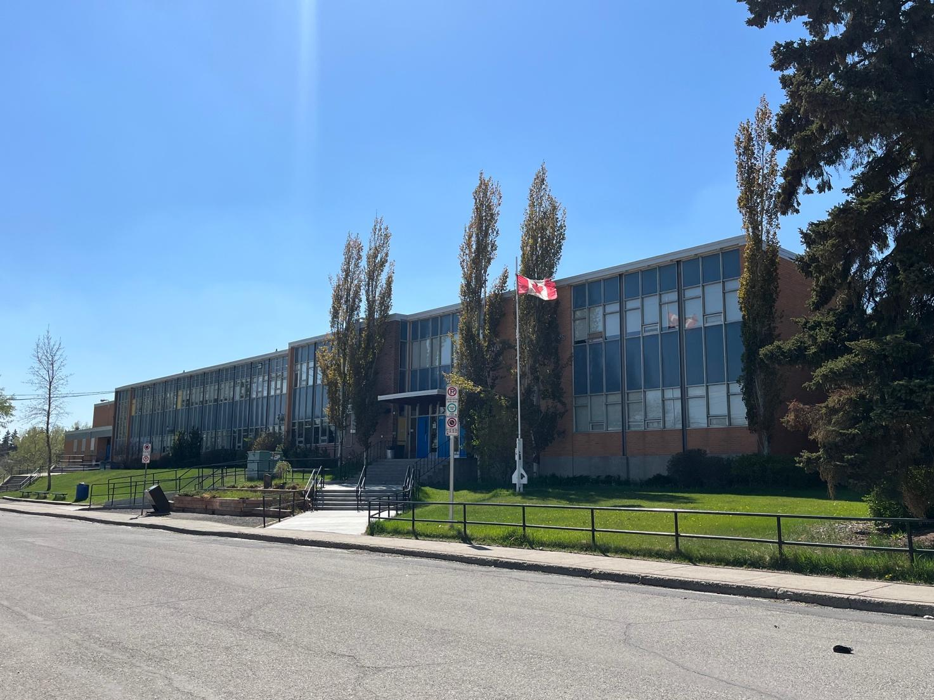
Purpose and Overview of school
1. Established in 2014
Instructing core subjects (Japanese language and Mathematics) alongside cultural education for children returning to Japan and Japanese children raised abroad.
2.Location: Senator Patrick Burns School (CBE rental) (Brentwood, NW)

Slide 3
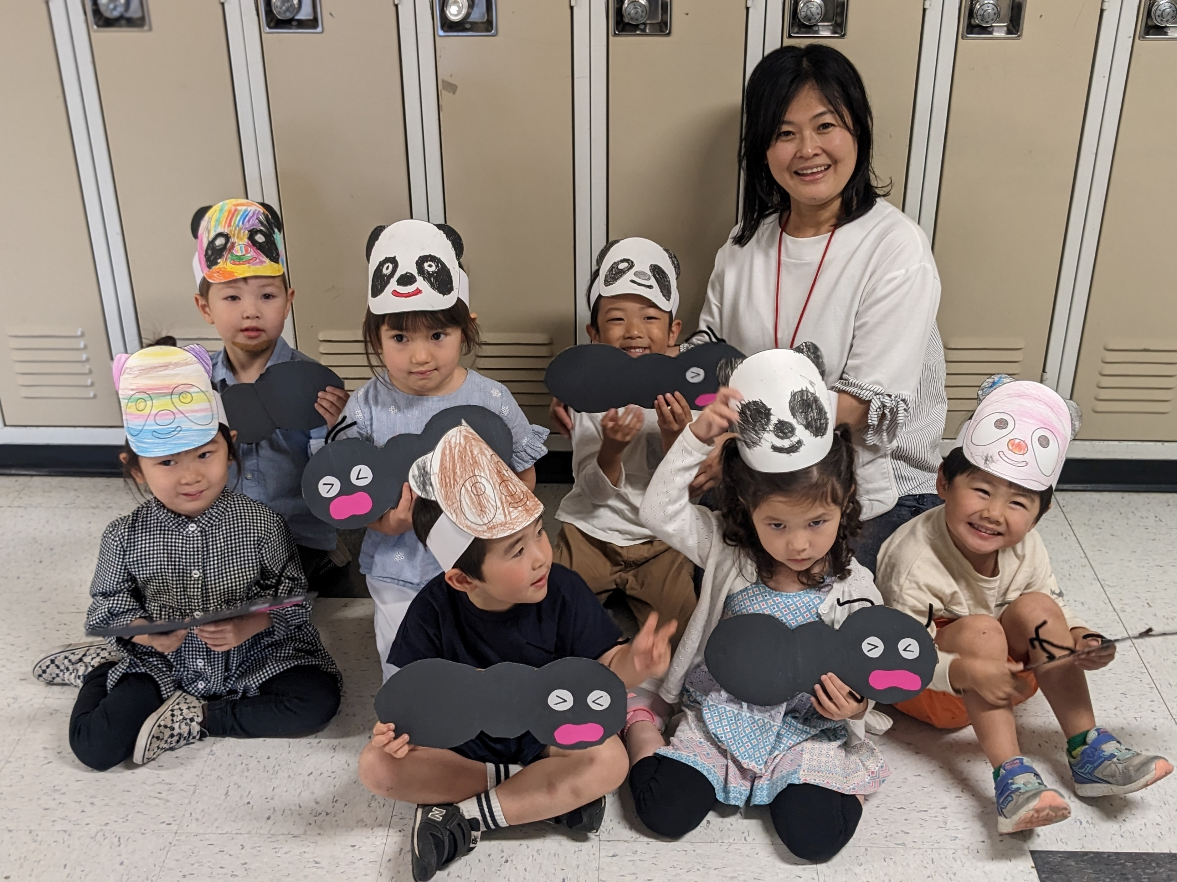
Pre-school and Kindergarten
The Pre-school and Kindergarten courses are designed as a preparatory program, focusing on teaching Japanese reading, writing, and culture. Through activities such as reading books, crafts, and songs, we aim to enhance Japanese language proficiency.
1. # of classes: 6 classes
(two classes each for 3-, 4-, & 5-year-olds)
2. # of students: 64 total
3. # of teachers: 3 teachers and 3 assistant teachers
4. Activities and events:
Entrance & Graduation Ceremonies
Recitals/presentations
Cultural Study Assembly
Sports Day
Evacuation drill and lockdown drill

Slide 4
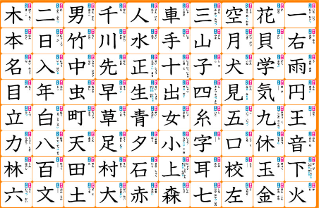
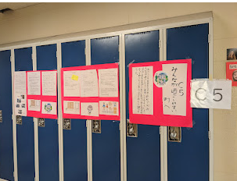
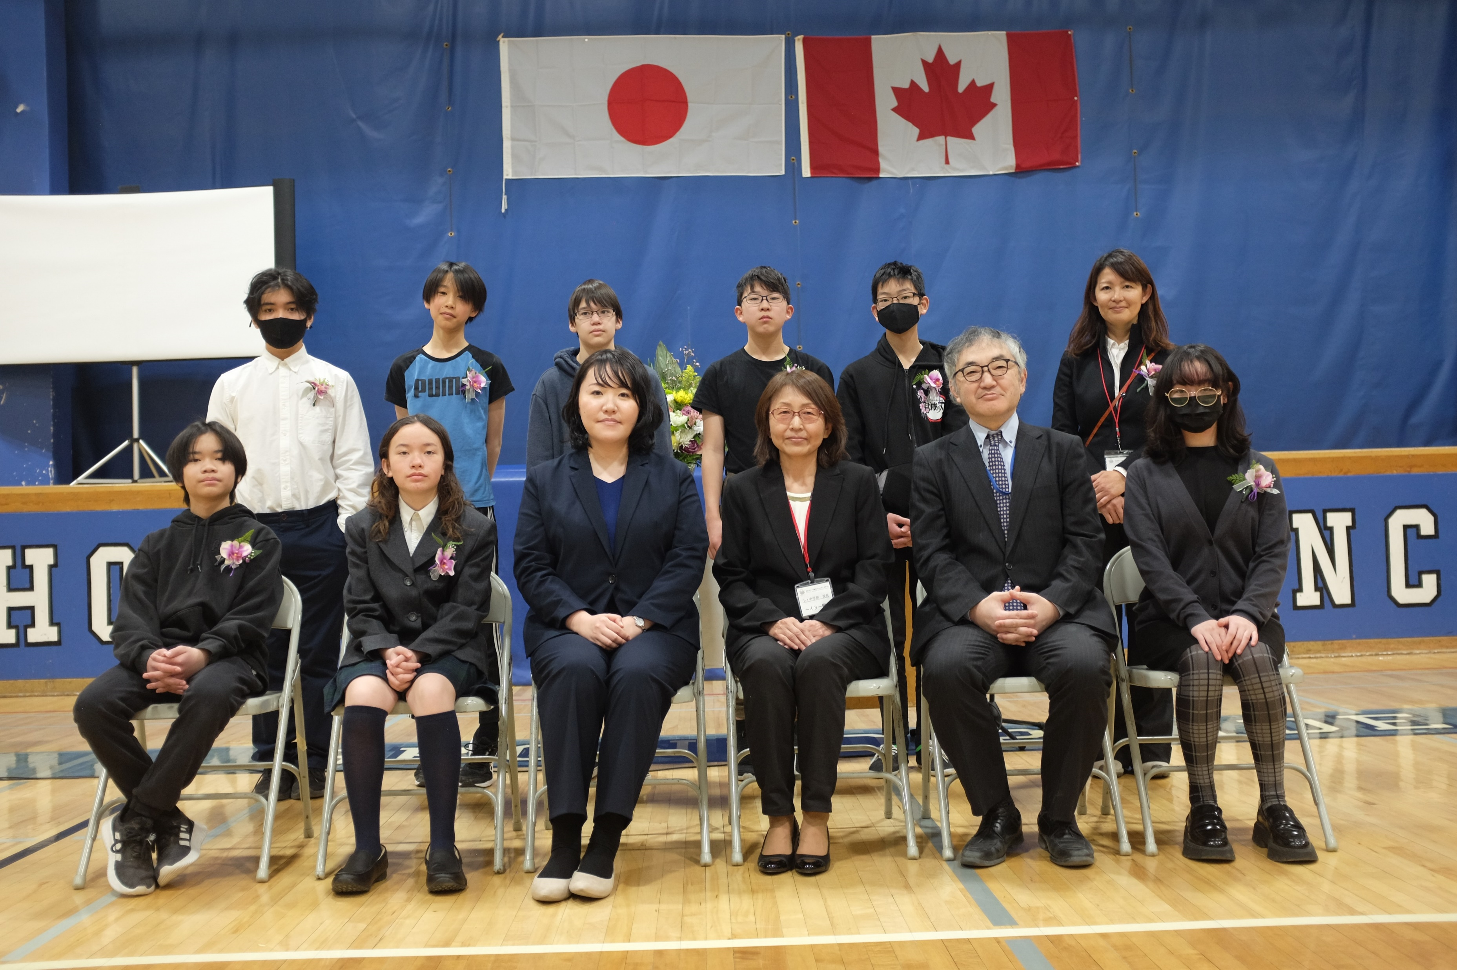
Elementary and Junior High
Following the guidelines set by the Japanese government, we use textbooks from Japanese elementary and Junior High for instruction.
1. # of class: Grade 1 to Grade 9 (9 classes)
2. # of students: 90 total
3. # of teachers: 9 teachers and 4 assistant teachers
4. Activities and events:
Entrance & Graduation Ceremonies
Presentation Week
Sports Day
Kanji & Math Contest
Evacuation drill and lockdown drill

Slide 5
Roles and responsibilities of school leadership team
1. Principal
Providing overall leadership, setting educational goals and policies
Ensuring effective communications with teachers, students, and parents
2. Teachers
Planning and delivering lessons according curriculum
Assessing student progress and creating report cards
Ensuring parents understand their child's progress and attitude towards learning.
Attending meetings, participating in school events

Slide 6
3. Volunteers (parents) All parents volunteer for various activities such as sports day, library assistance, and ceremonies. Enhancing the school community through their contributions and involvement.
2. Parents
Supporting their children’s language acquisition.
Participating in parent-teacher meeting
Participating in volunteer activities
3. Students
Actively engaging in their learning and follow school rules.
Speaking in Japanese while at school and striving to improve proficiency in Japanese language, ( Don’t forget to have fun!)
Be kind and respectful toward each other.

Slide 7
Language school operations, budget and overhead costs
Facility rental fee: CBE school rental (13 classroom + Gym)
Teacher’s salary: The starting salary is $26, with a $1 raise each year.
Funding: We receive a subsidy from the Japanese government for part of the rental and part of the teacher’s salary. The amount of the subsidy varies each years.
Fundraising: We are not conducing fundraising.

Slide 8
School Collaboration
There are 8 schools like ours in Canada that receive subsidies from the Japanese government and hold annual workshops.

Slide 9
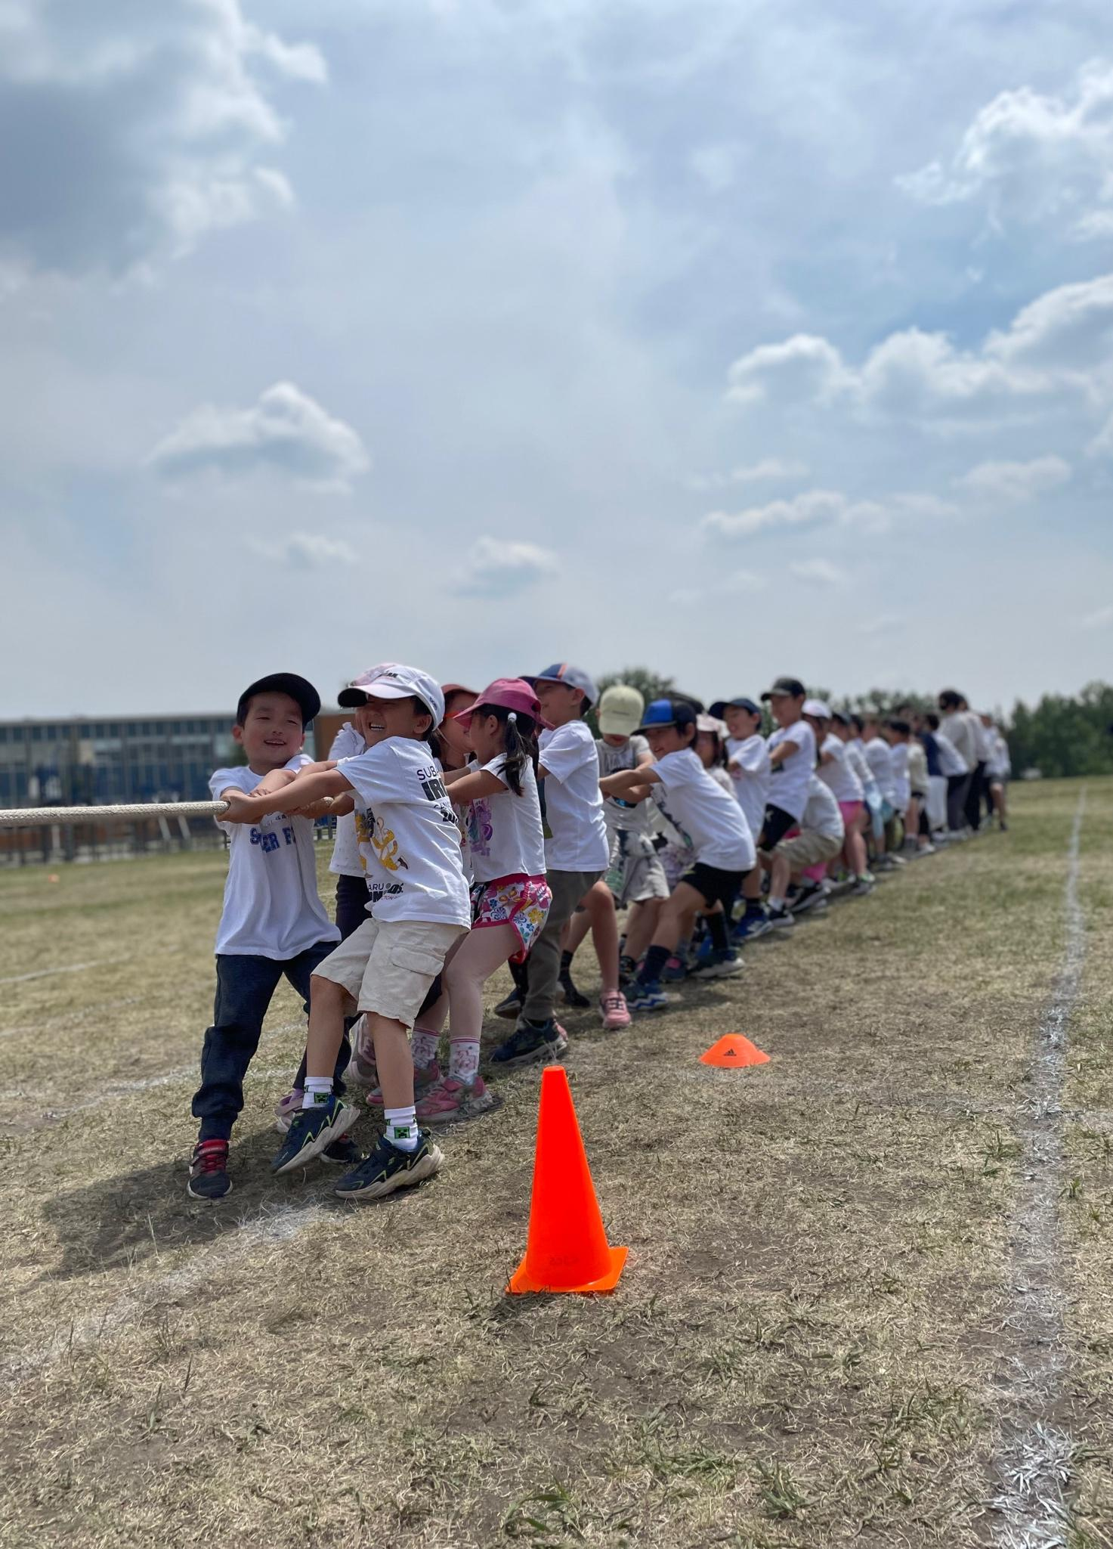
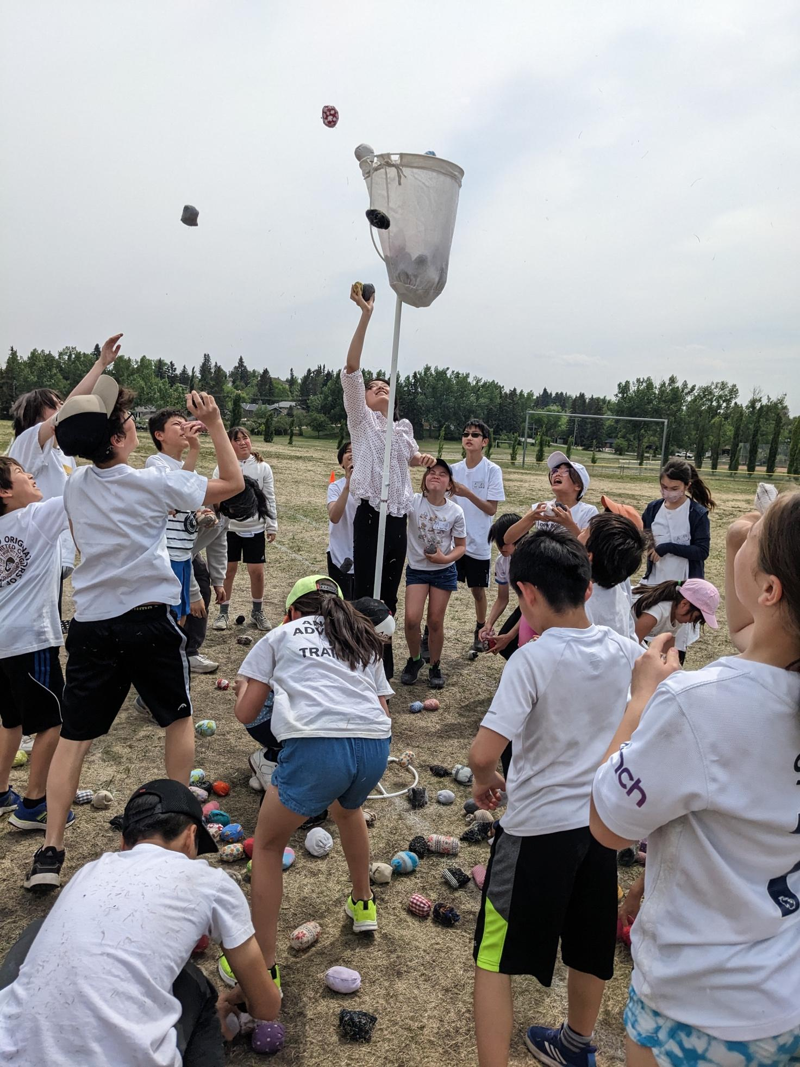
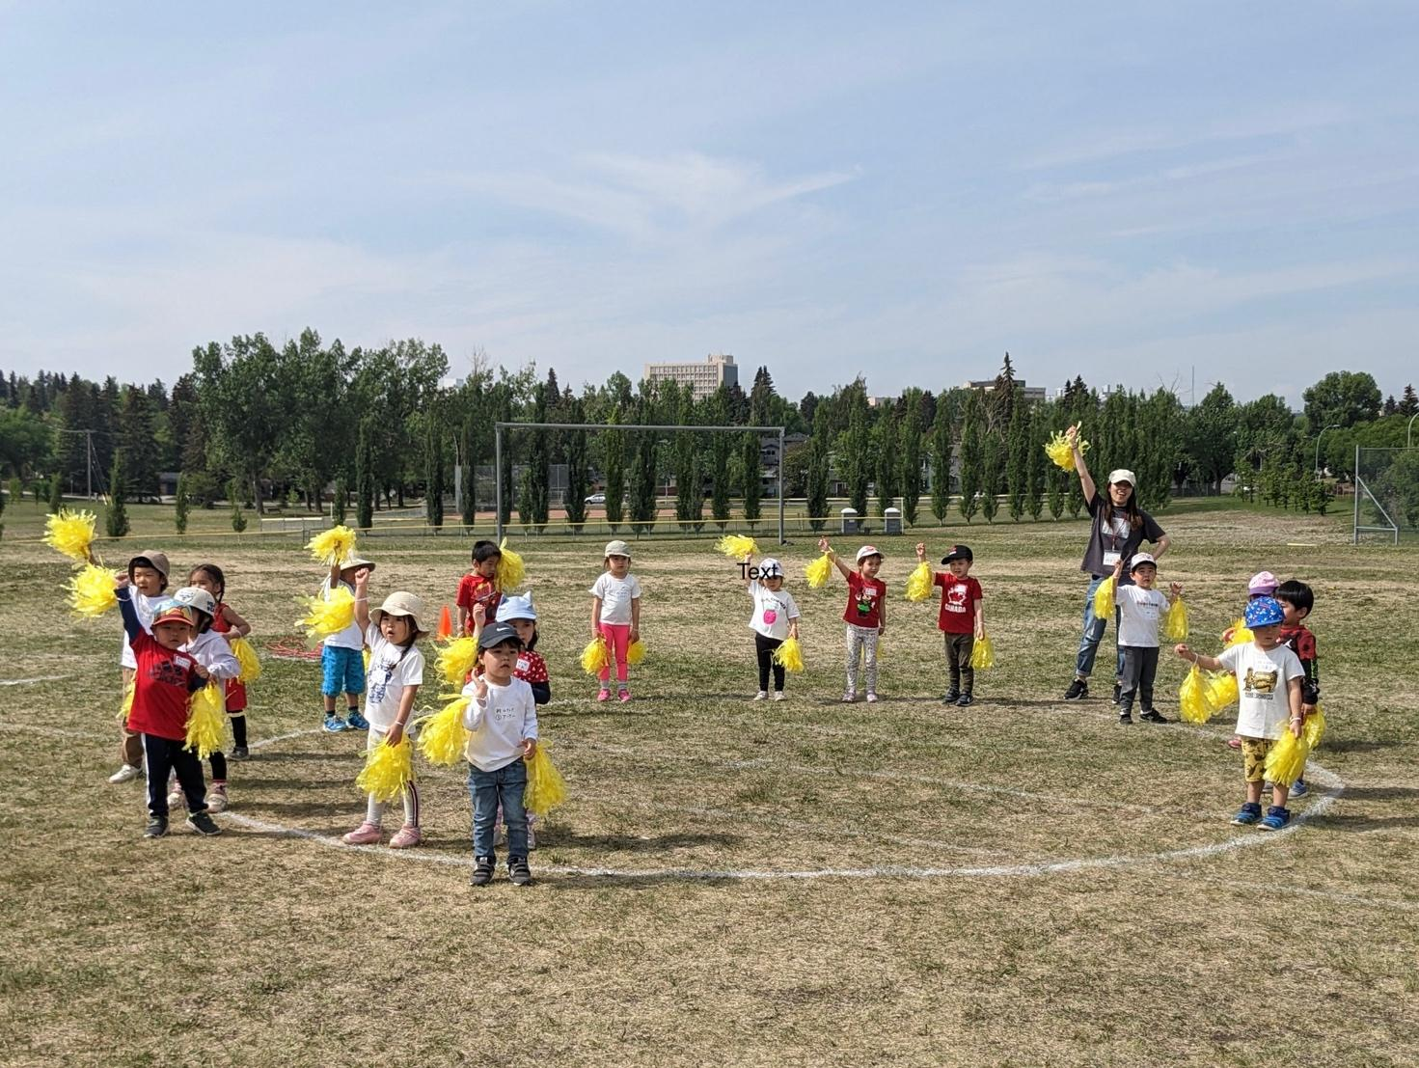
School achievement/successes
On June 8th, we held our annual sports day event. We would like to share some photos. Every year the students are looking forward to this event and enjoy every game.

Slide 10
School challenges
School challenges include:
Finding and retaining teachers.
Allocating time for teacher training.
Maintaining an affordable tuition fee.
Encouraging motivation in junior-high level students.

