Slide 1
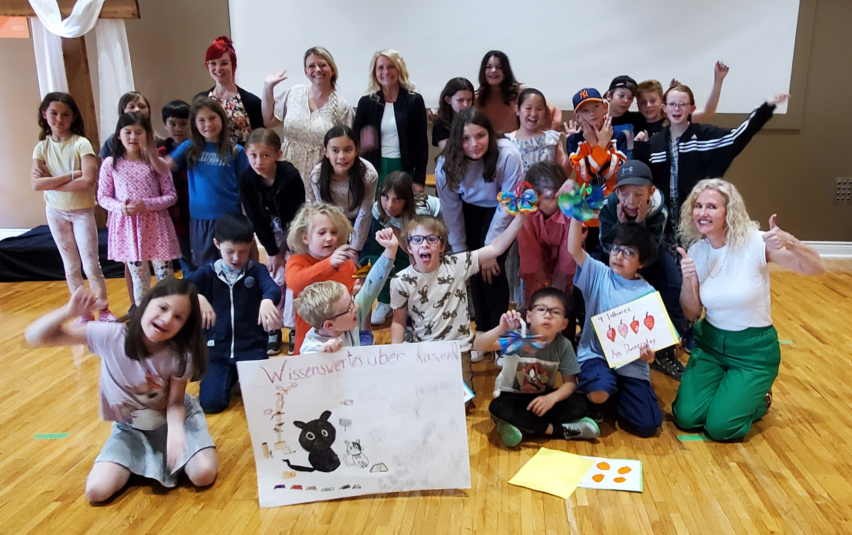
Calgary German Language school
Curriculum Whaat?
June 22, 2024

Slide 2
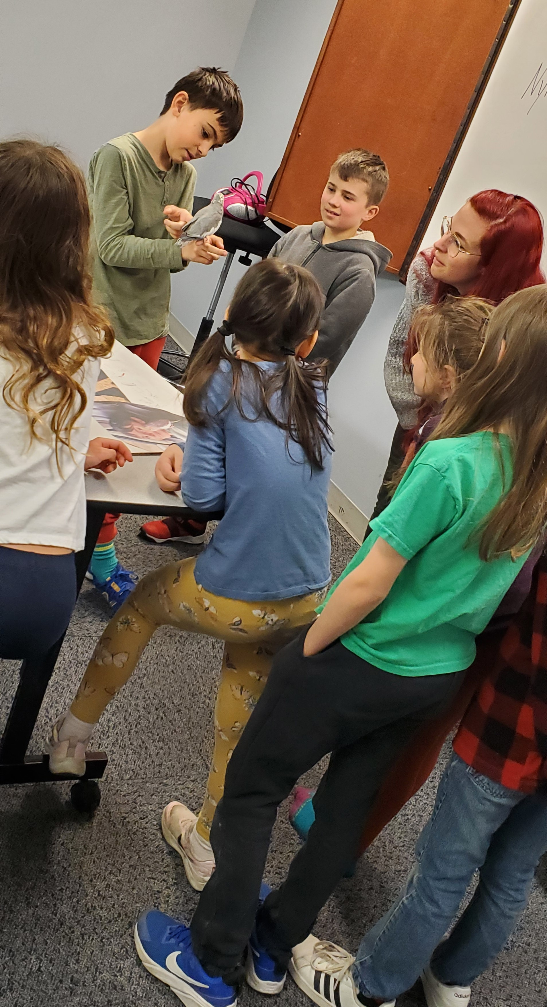
Let’s talk about it!
Where do we start?
What’s the objective?
How are we going to get there?
What does success look like? When do we measure?
Who is involved? Creating, researching, implementing?
What do you choose to keep? Who decides? When is the right time to look for new materials? What about the old adage if it ain’t broke why fix it?

Slide 3
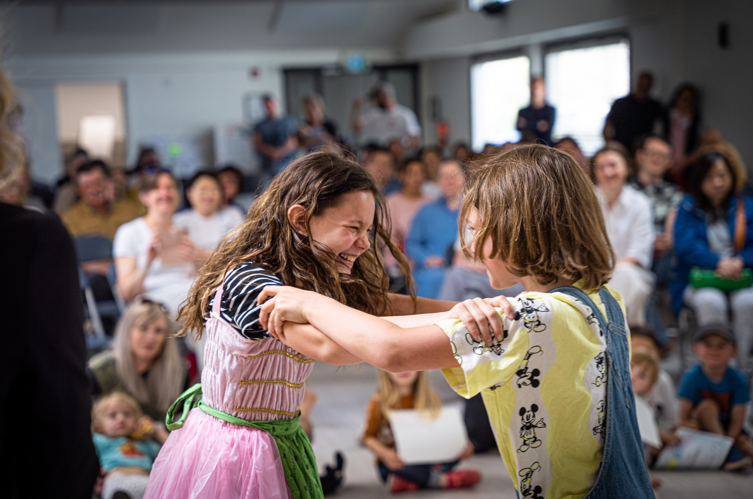
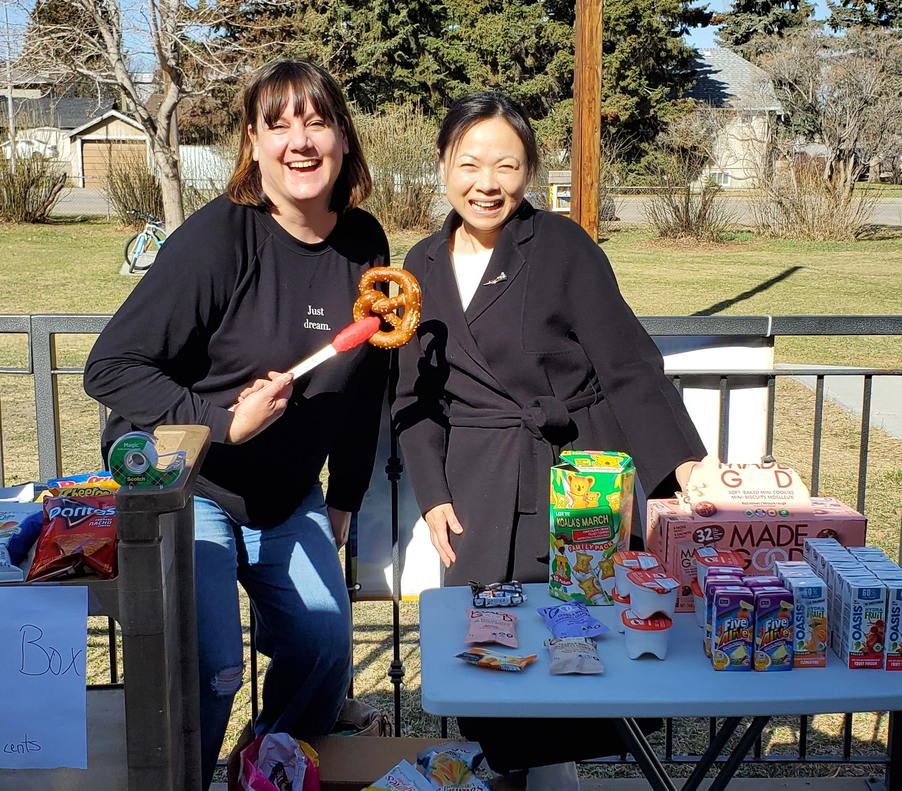
Objective. The why?
Mission statement www.calgarygermanschool.com
Calgary German Language School
We provide quality German language education to students of all ages and ability levels and encourage, foster and develop connection to the German culture.
b. Retention Goals
In order to grow, connections need to be made both socially and academically.
Notes:
. Clearer the statement easier to measure. Relevance to the material, inspiration to continue, community building, benefits of continuing to study. . IE credits through Alberta Education for those that qualify…please refer to the handoutMaking sure the contact hours, leveled materials, testing and a certified teacher to oversee the final marks submitted to AB Ed. Researching the curriculum standards from AB Ed and the materials meet and exceed the requirements. Invite your community in to your school. Share your goals and work together to get there.

Slide 4
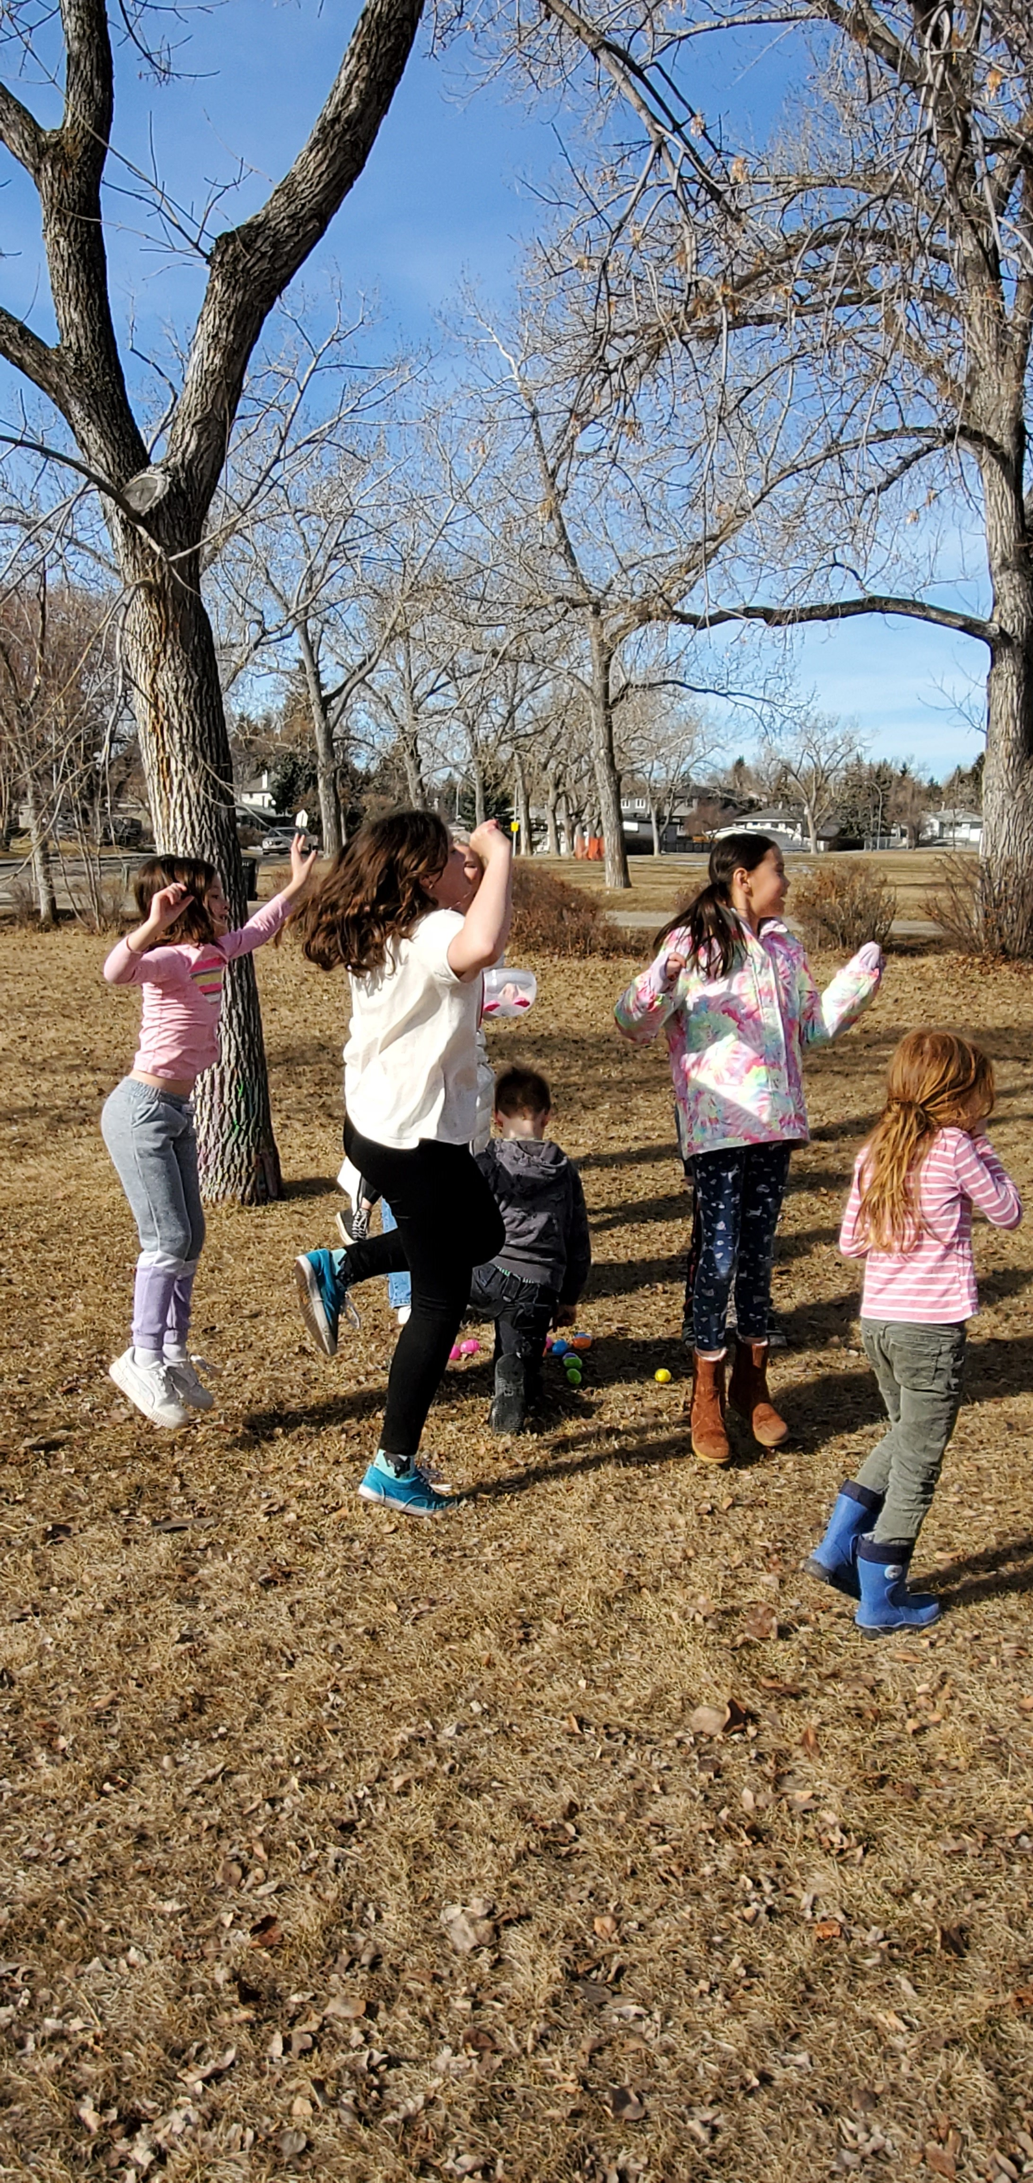
“There is no subject so old that something new can’t be said about it” Dostoevsky
What does curriculum mean to you?
The expectations for what will be taught and what students will do in a program of study. It’s the gathered information that has been considered relevant to a specific topic. www.1ude.edu
Objective is for students to demonstrate growth through regular assessments, measured writing and reading markers as well as specific standards for oral fluency, clearly express connectivity to the materials and link to cultural associations.
Notes:
Curriculum is not solely dependent on a text book or specific philosophy of teaching. It’s a cycle as to what will be taught which is in direct correlation with the objective, or mission statement for the school. It is an evolution of subject matter.

Slide 5
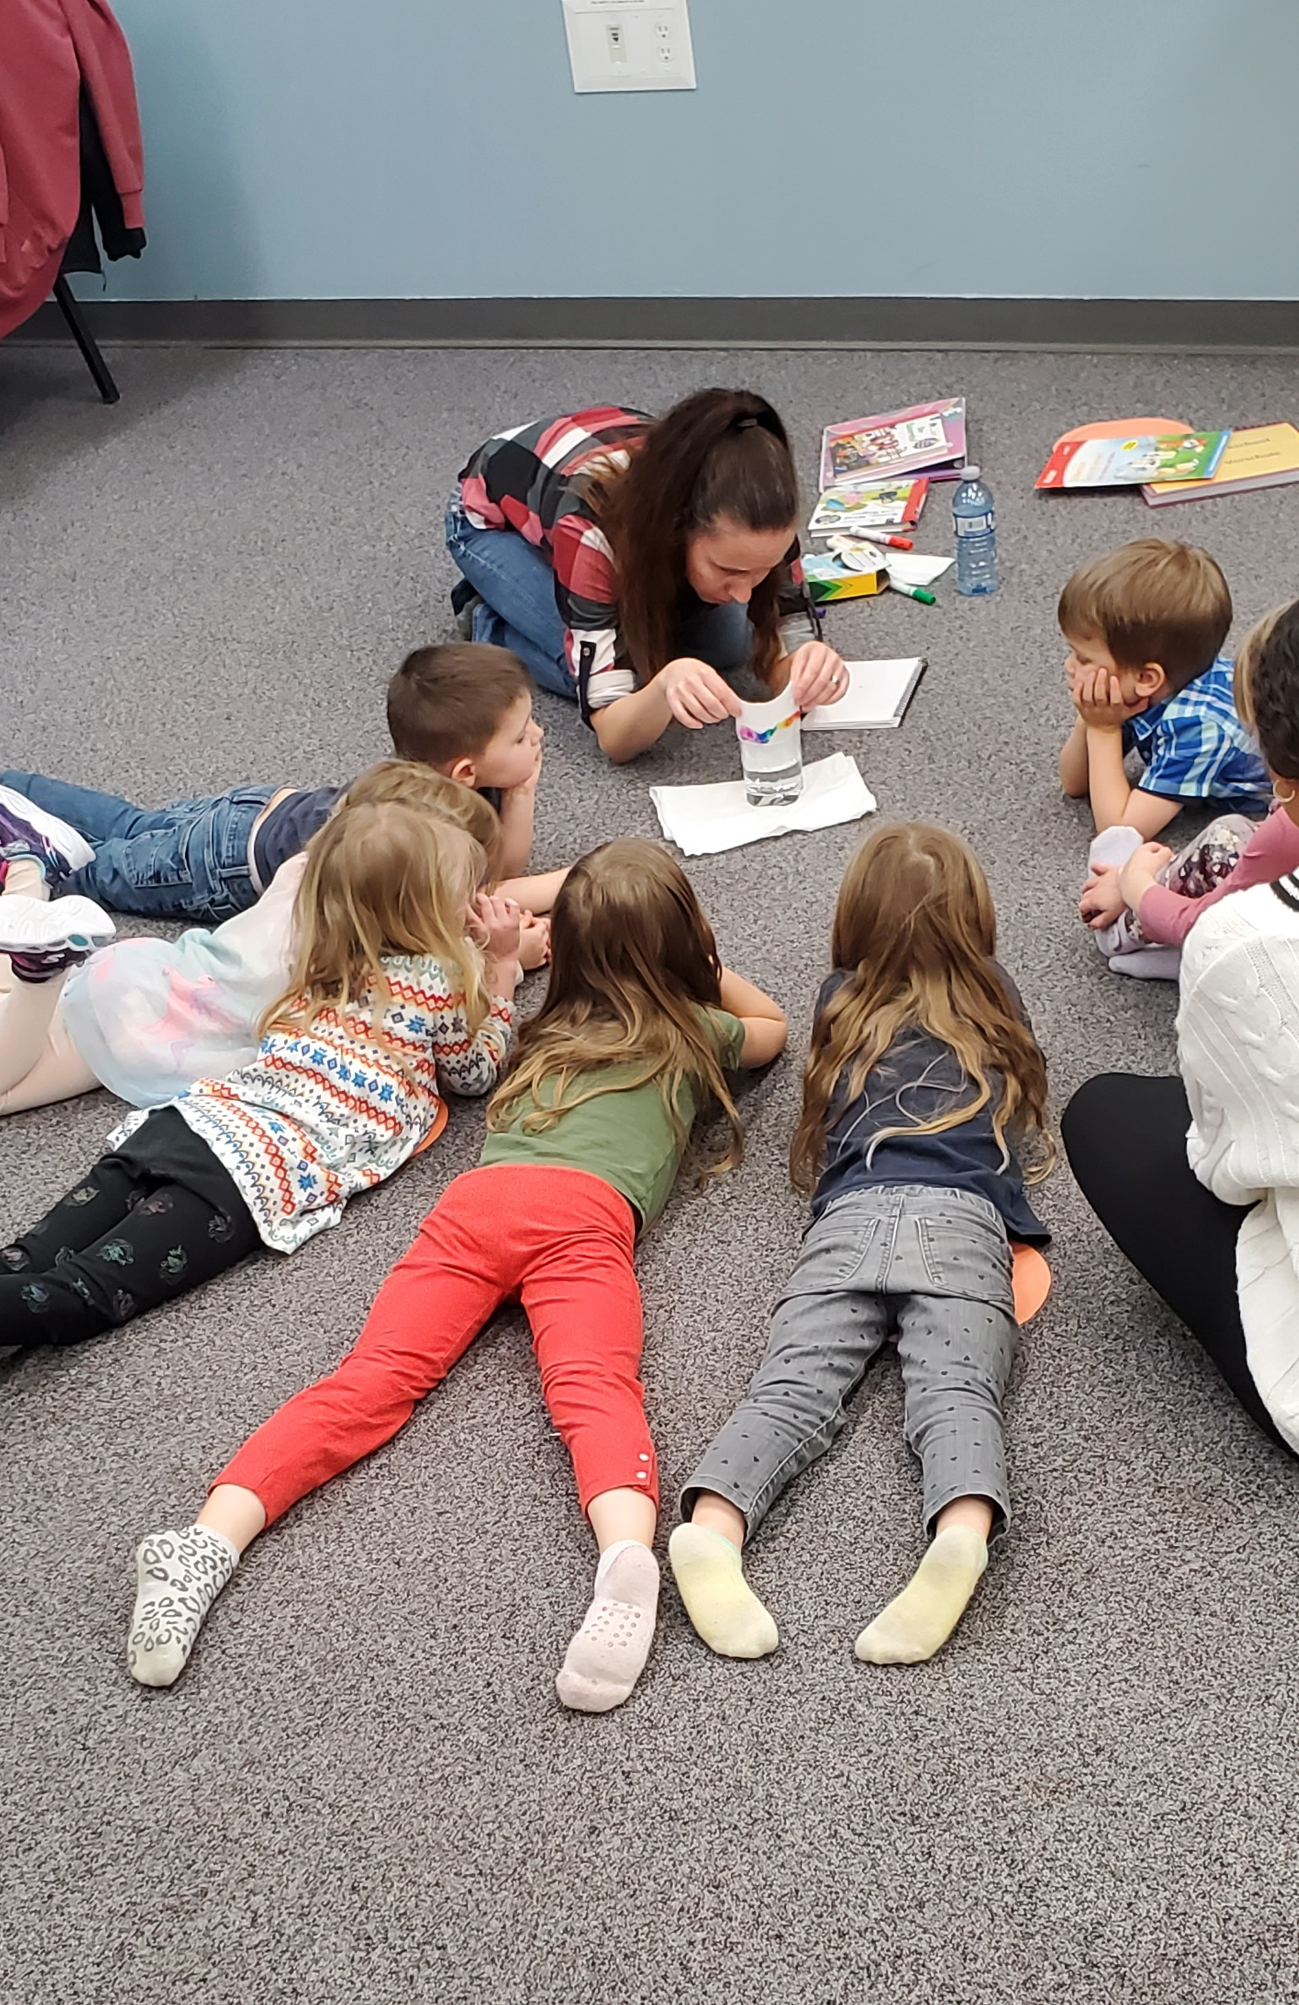
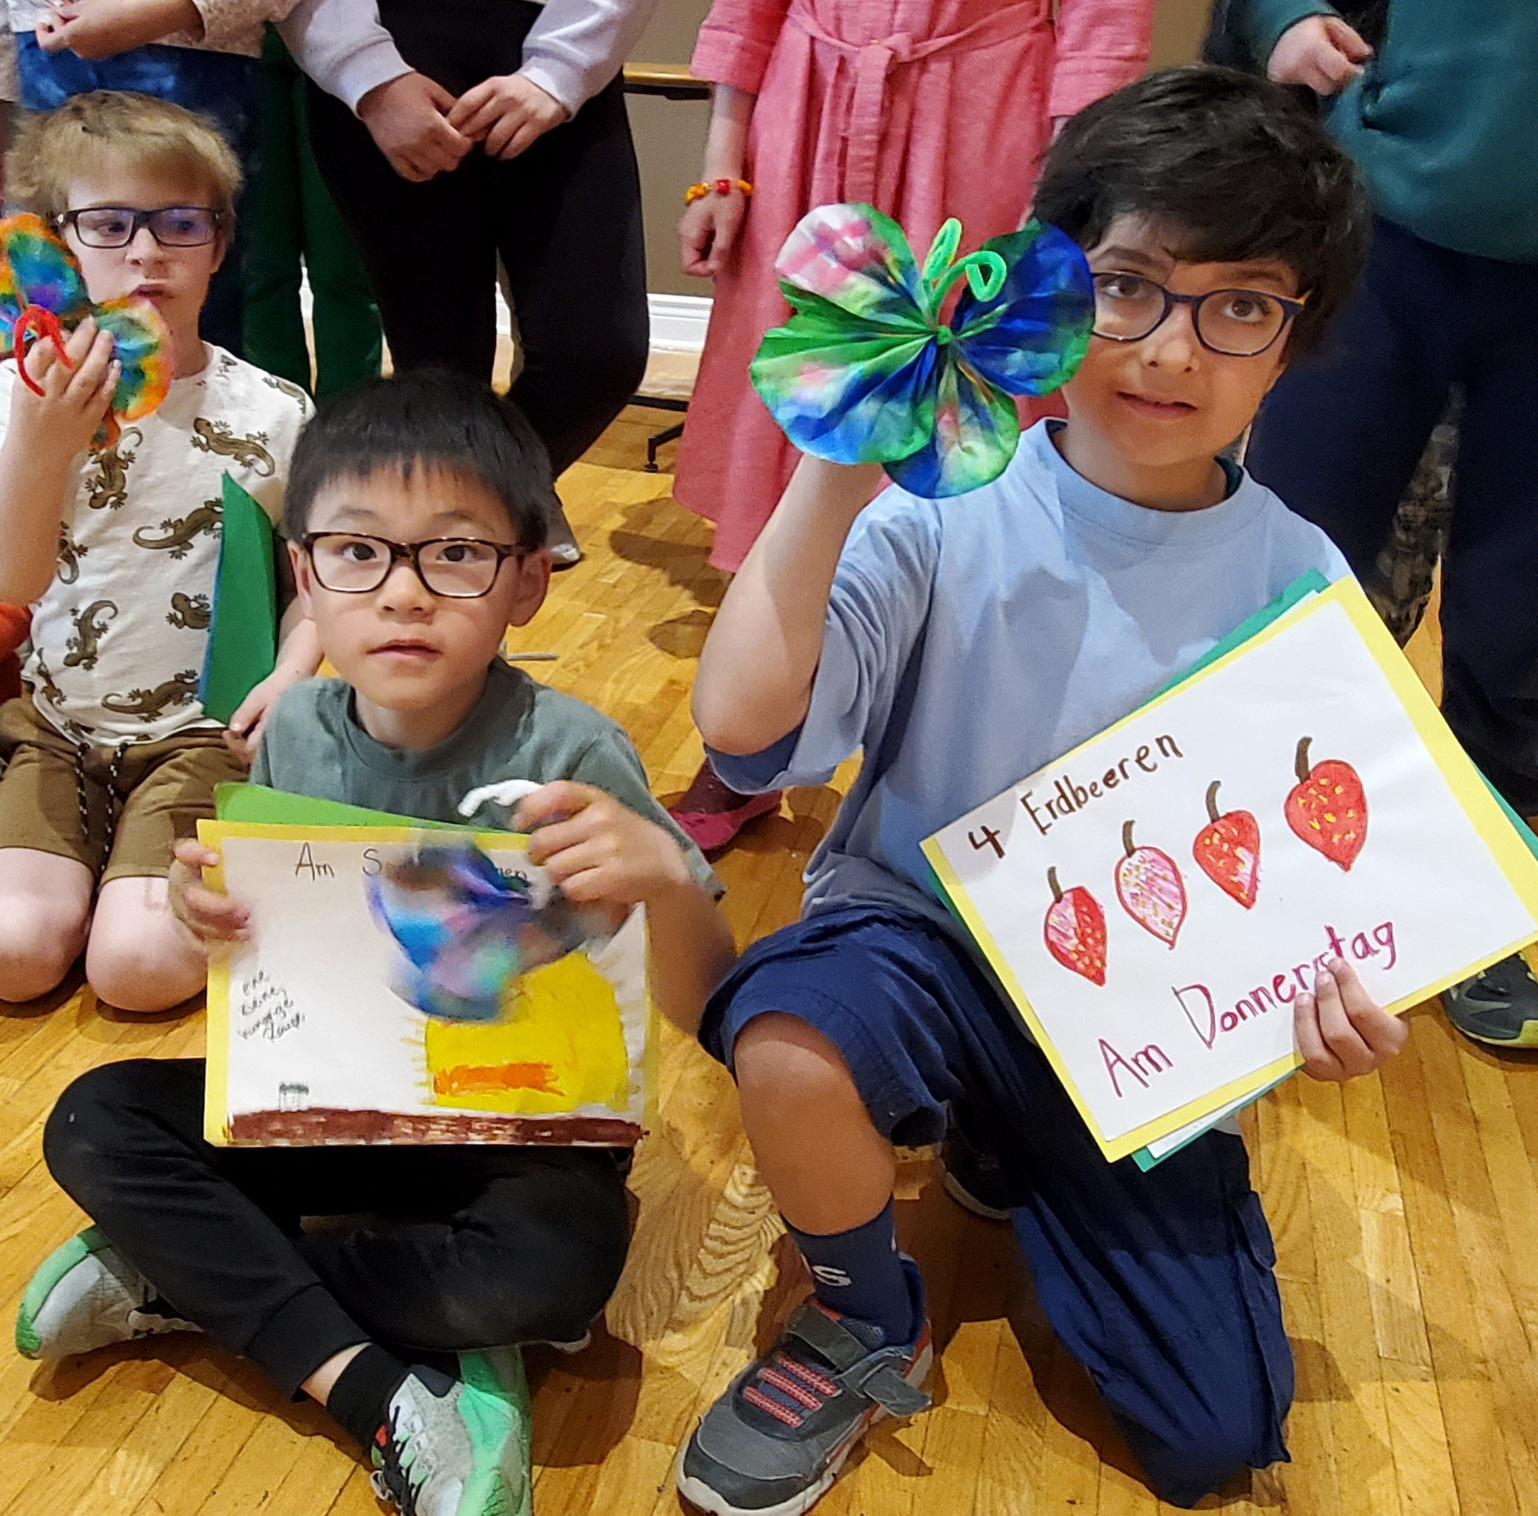
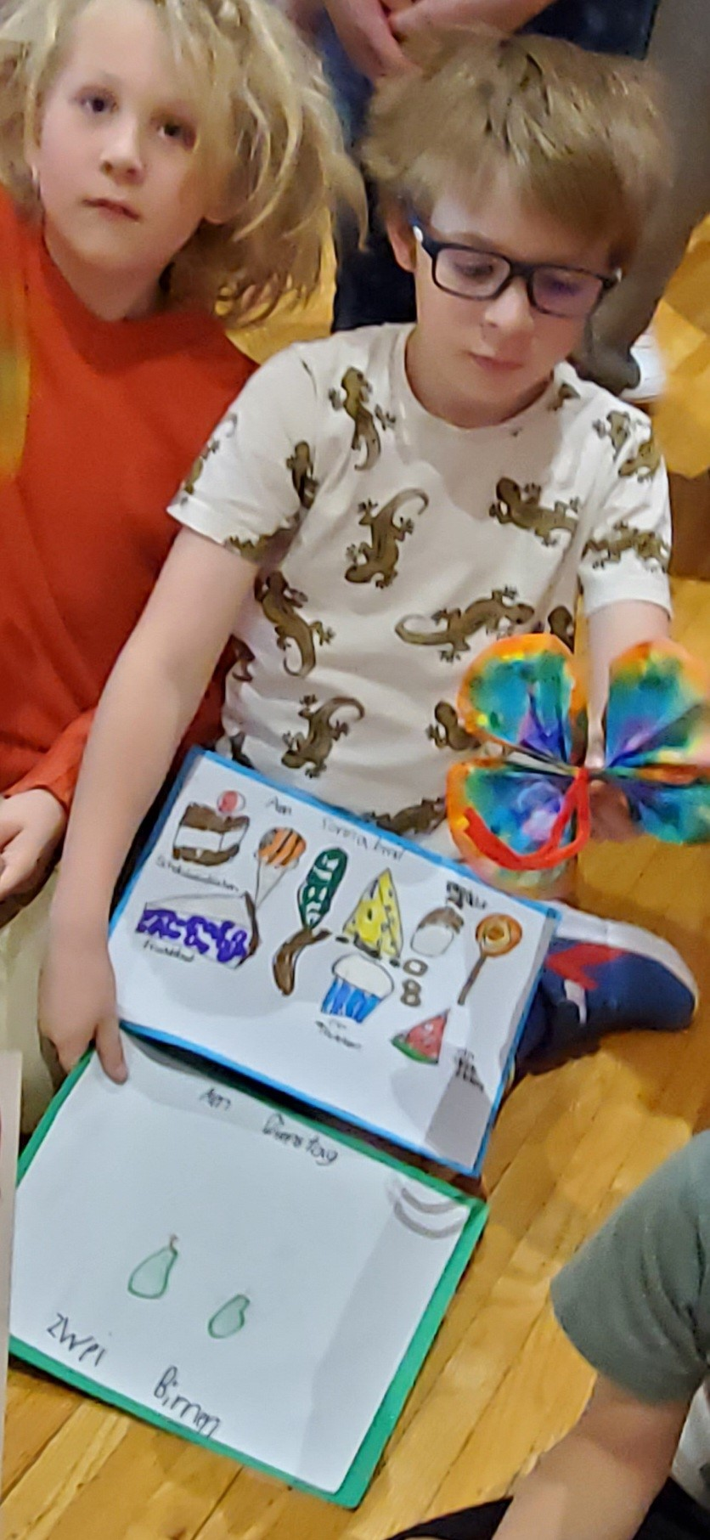
Where do we start?
Program to be offered / ages of students?
Proficiency stages or skill sets?
How classes are formed?
Teacher expectations
Target language % in each class, reality?
Notes:
a. CGLS Junior Kindergarten – Adults b. Pre and post standardized tests, formal and informal assessments throughout the class time, cut off dates for changes, previous experience and age. Preparedness of teachers and language proficiency. Timing is key. C. Classes and ages can be mixed depending on skill sets. However, classes and materials need to be adapted and age appropriate, important to have text books/workbooks that have been modified and used for your class while meeting the overarching objective. Ensuring that each skill set is moving forward and that there are measurable outcomes for each level.
CGLS uses a grammar “red thread” for classes A1-high school. We use the Modalsatz (how something happens) versus a “cause sentence” A causes B. Kids begin using this more extensively the higher their skill sets usually around grade 3 when they have a better handle on sentence structure. Each consecutive class then builds and makes it more complicated as more complex sentences are explored. D. Age and experience of students is appropriate for skill required as per the material. Weekly updates and communication sent to parents and students and reinforces contact with the target language required for the week through homework or suggested activities. Teachers need parental/caregivers support for skills to increase and student success with the material.

Slide 6
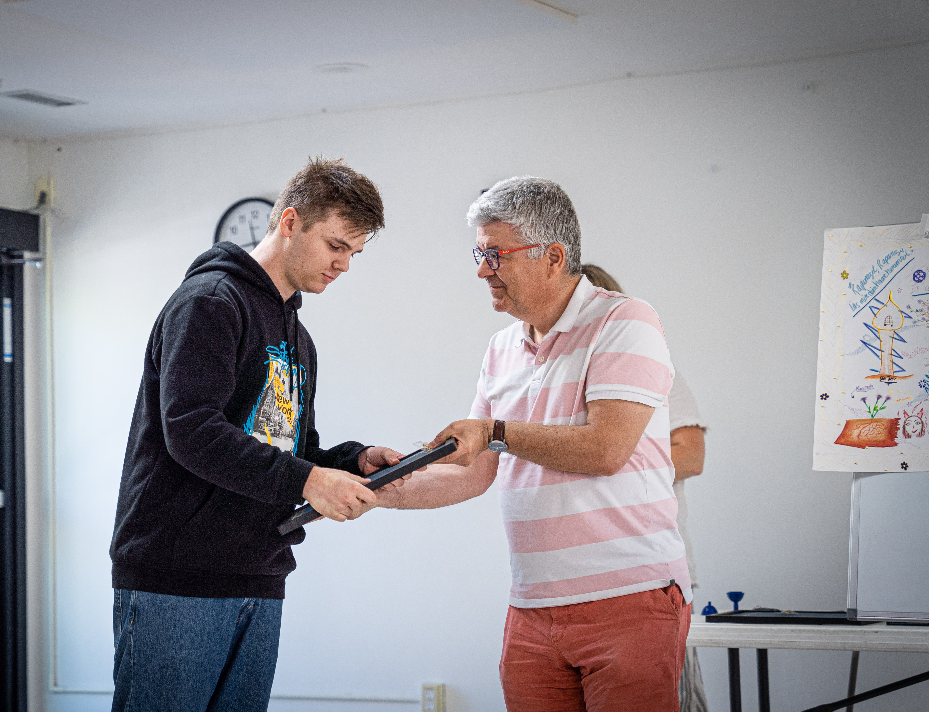
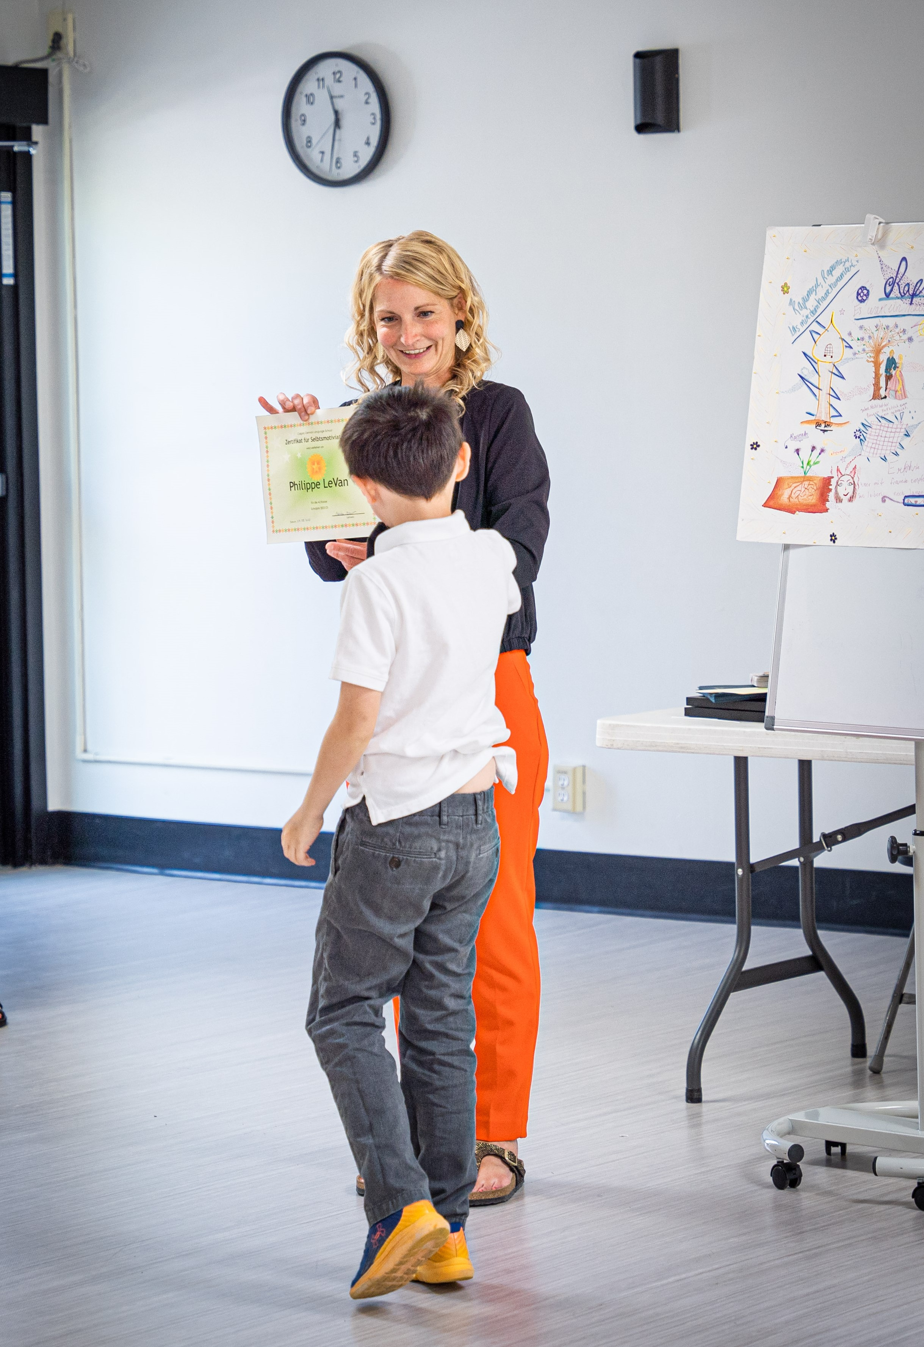
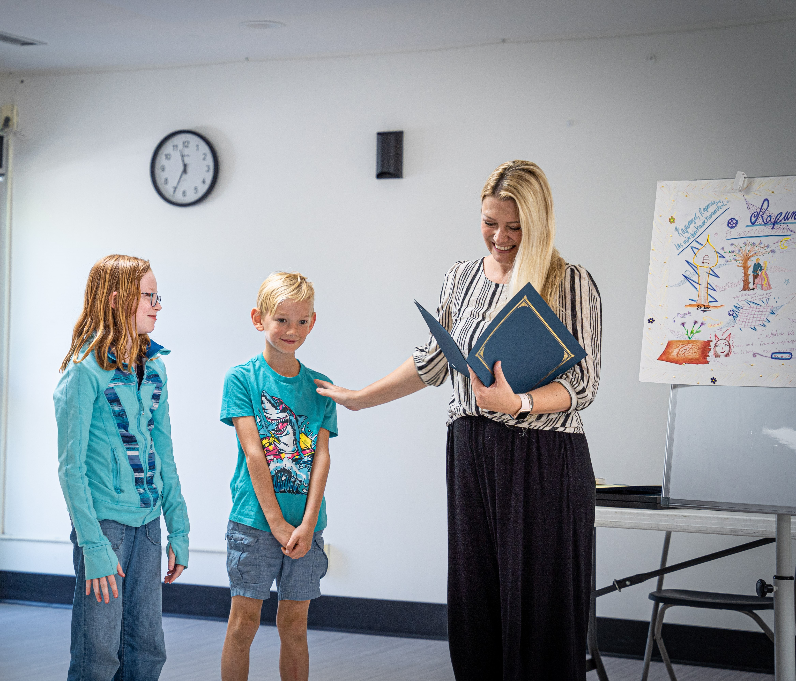
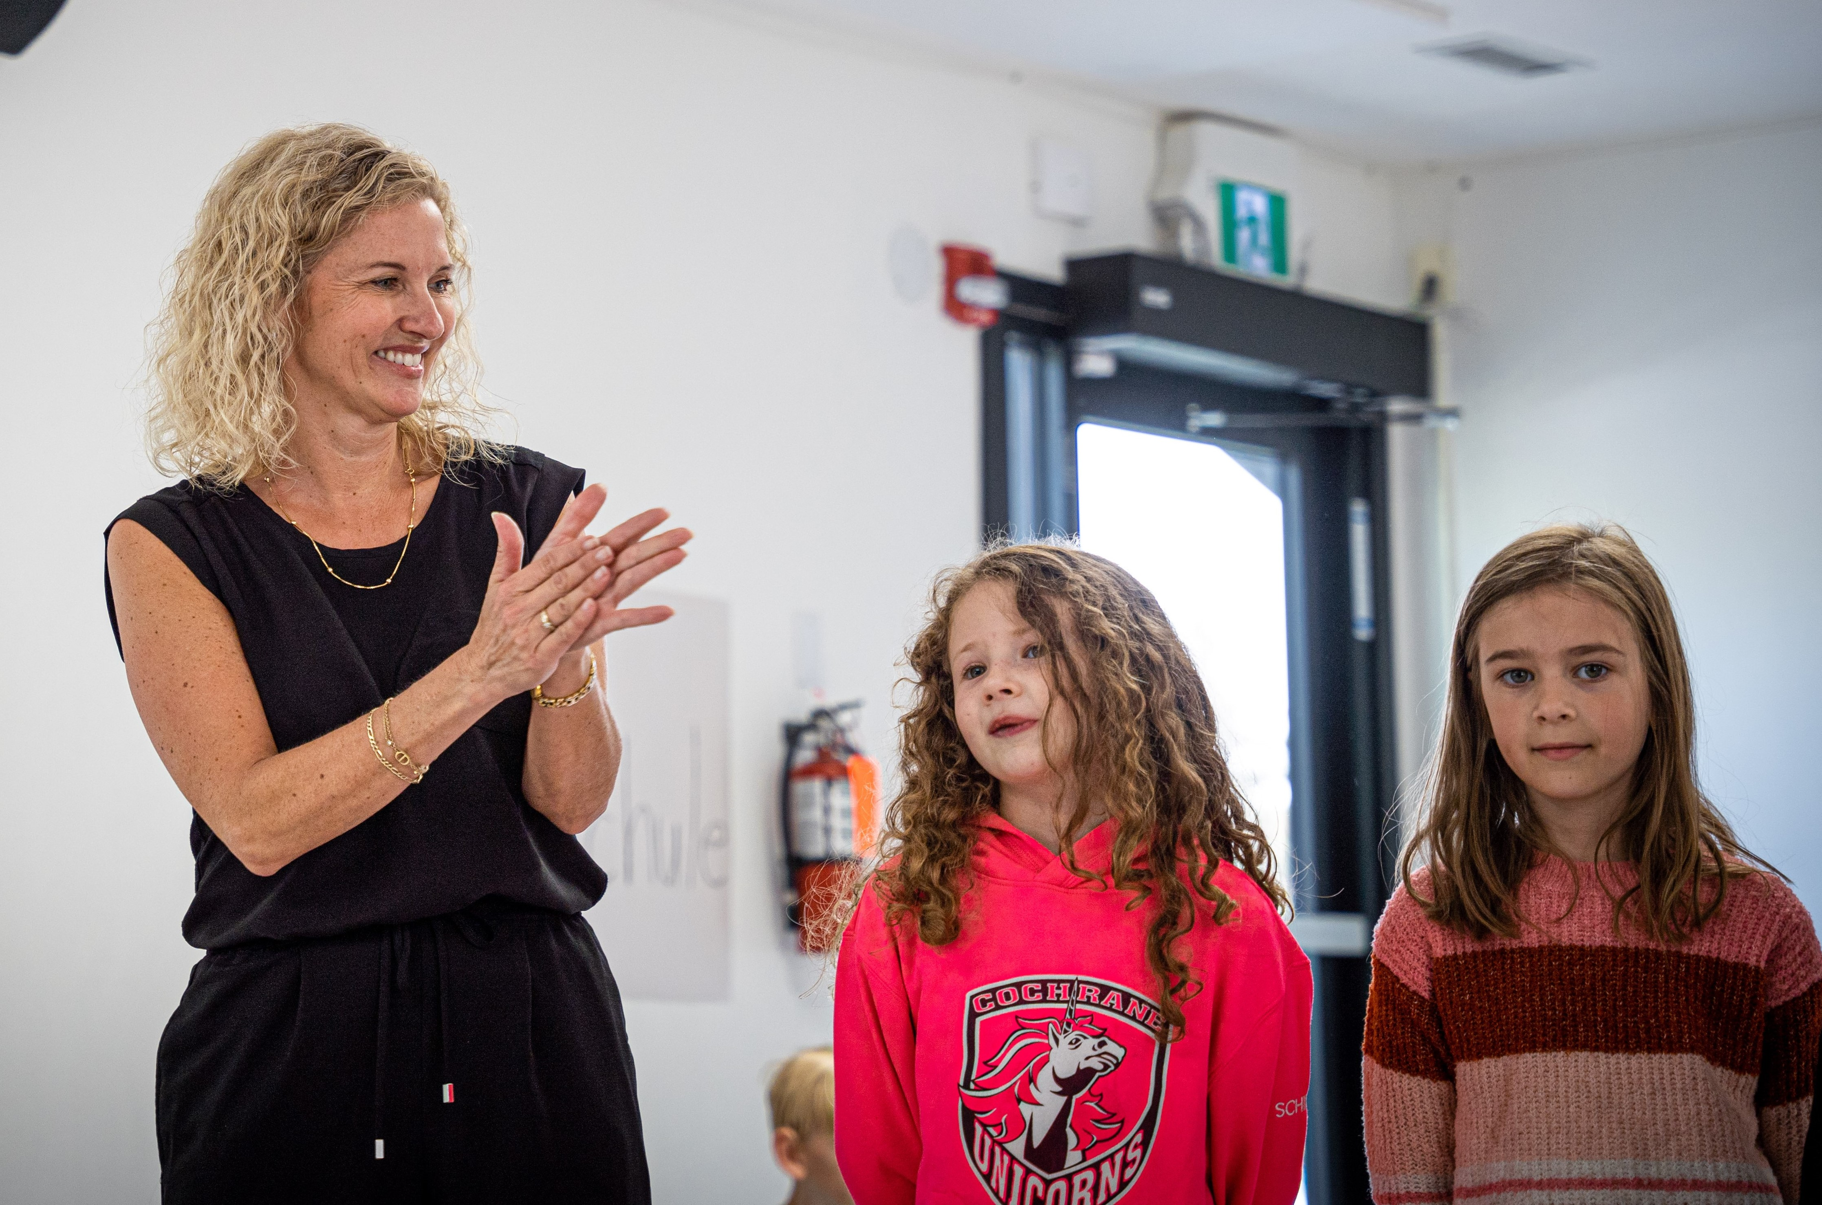
Measuring Success
Regular Assessments
Assessments should be conducted on a regular basis both formally and informally for every class .
A familiar story adapted and retold in the target language. Music, presentations, take time to get creative and keep it relevant and connected to the objective.
b. Standardized Exams from Individual Countries
Help students prepare with intentional teaching to develop stamina, confidence, and proficiency. CGLS offers intensive course focused preparation for DSD1 and DSD2
Some public institutions offer tests or samples of them. Many formalized exams from home countries have samples and sometime there are specific texts targeting exam skills.
c. Compliance with AB Ed or CEFRL other credit agencies from home countries
Important to do regular curriculum review and development with your teachers and program wide to ensure compliance with the standards and your objectives meeting and or exceeding those standards
Notes:
a. There are a variety of ways to assess students of all ages and doesn’t have to be onerous. However, I caution you to not do assessments for the sake of giving a test. The assessments should be measurable and clear connection to the objective for each class as well as the overarching curriculum standards. Here are some examples with our children’s program. B. Formal testing and regulated by home country. . A1 and A2 are done in class with intentional teaching for specific standards and skills required by the exam. C. . AB Ed has material posted on their websites and it takes time to audit yourselves that standards and contact time with the language are being met. This includes contact with the target language outside of class. Other language institutes with standardize testing
Some public institutes offer tests or samples of them. Most formalized testing from home countries have samples and there are specific texts targeting exam skills.

Slide 7
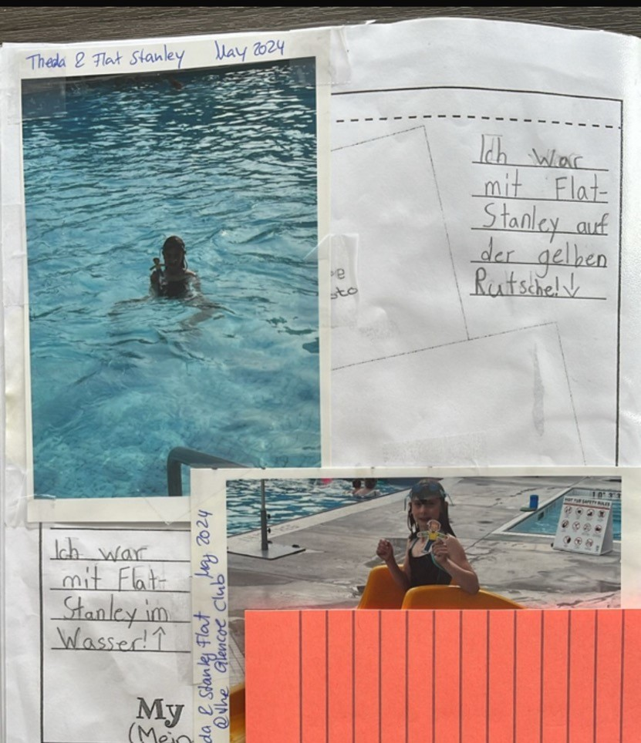
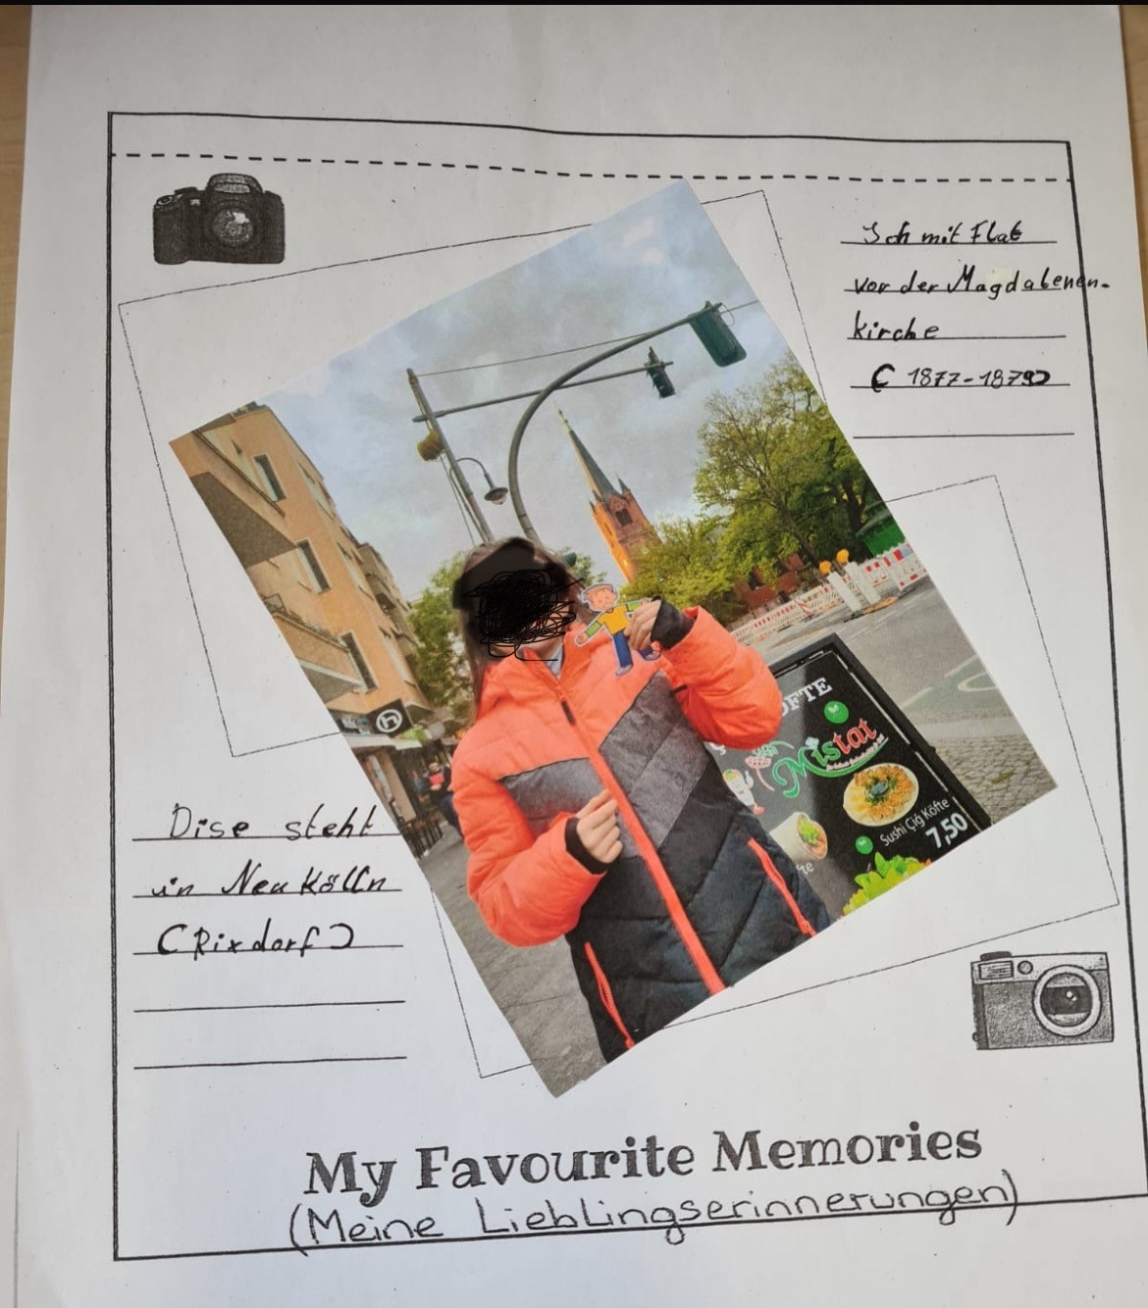
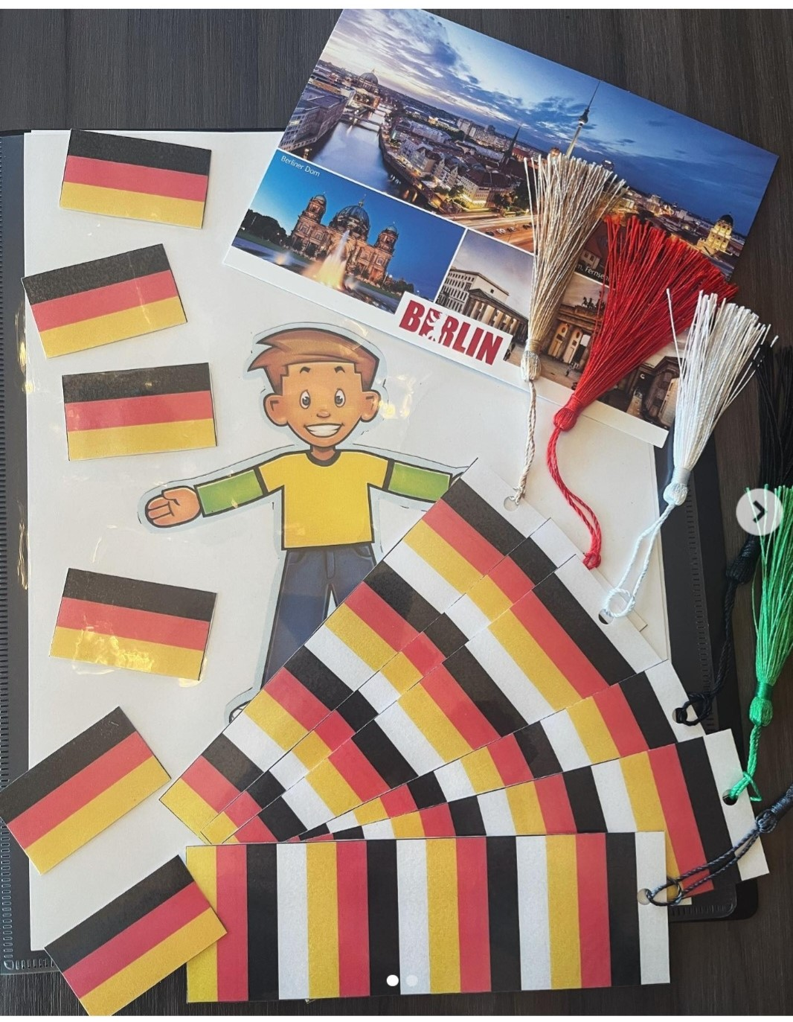
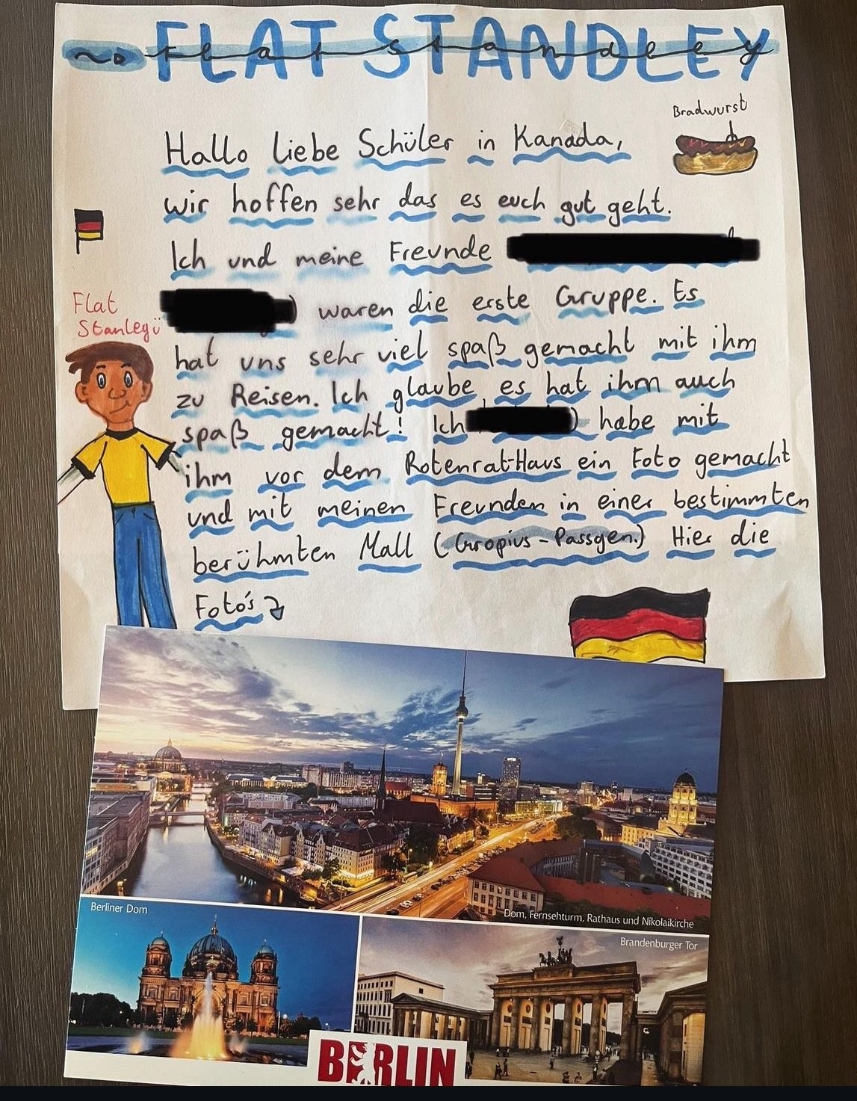
Beyond the Classroom
Authentic language
Language and skills not limited to a text book
Example the flat Stanley Project. Collaborating with another school from your target language group.
b. Availability/Monetary Investments
Leave plenty of time to order and receive texts, and review prior to purchase and find out if there are support materials available electronically along with licensing
c. Publishers, In House Development (standards met)
Always keep in mind the objective and ask yourself: Why this and not that? How is this relevant? How does it connect to the objective? And so on
d. Current Text or Relevant Cultural Themes
Students leading the research and allowed to get creative how it is presented
*Technology
Can be also useful as an assessment tool and creative for online or hybrid programs.
Notes:
.a. Using resources like videos, written sources, connecting with others in the home country. B. If developing in house be prepared to invest time, research, a willingness to collaborate and use resources and lessons that worked. C. ie Vitamin de . Orally, using modern tech, creating short film, stories, and making sure the project is staying connected to objective and not just an exercise to have something to do. D. Don’t solely rely on apps, but use as a resource and supplement to engage in the language in more ways. Anton.de or group game apps.

Slide 8
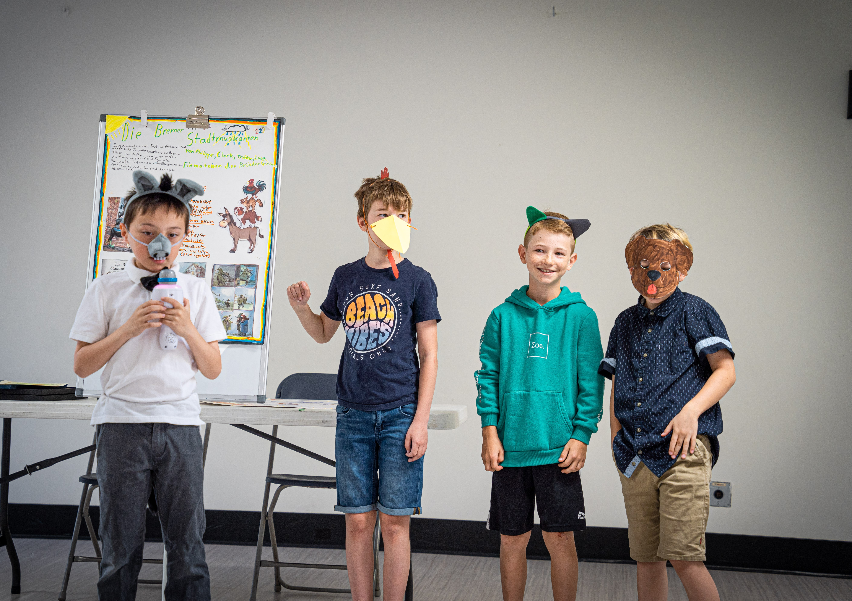
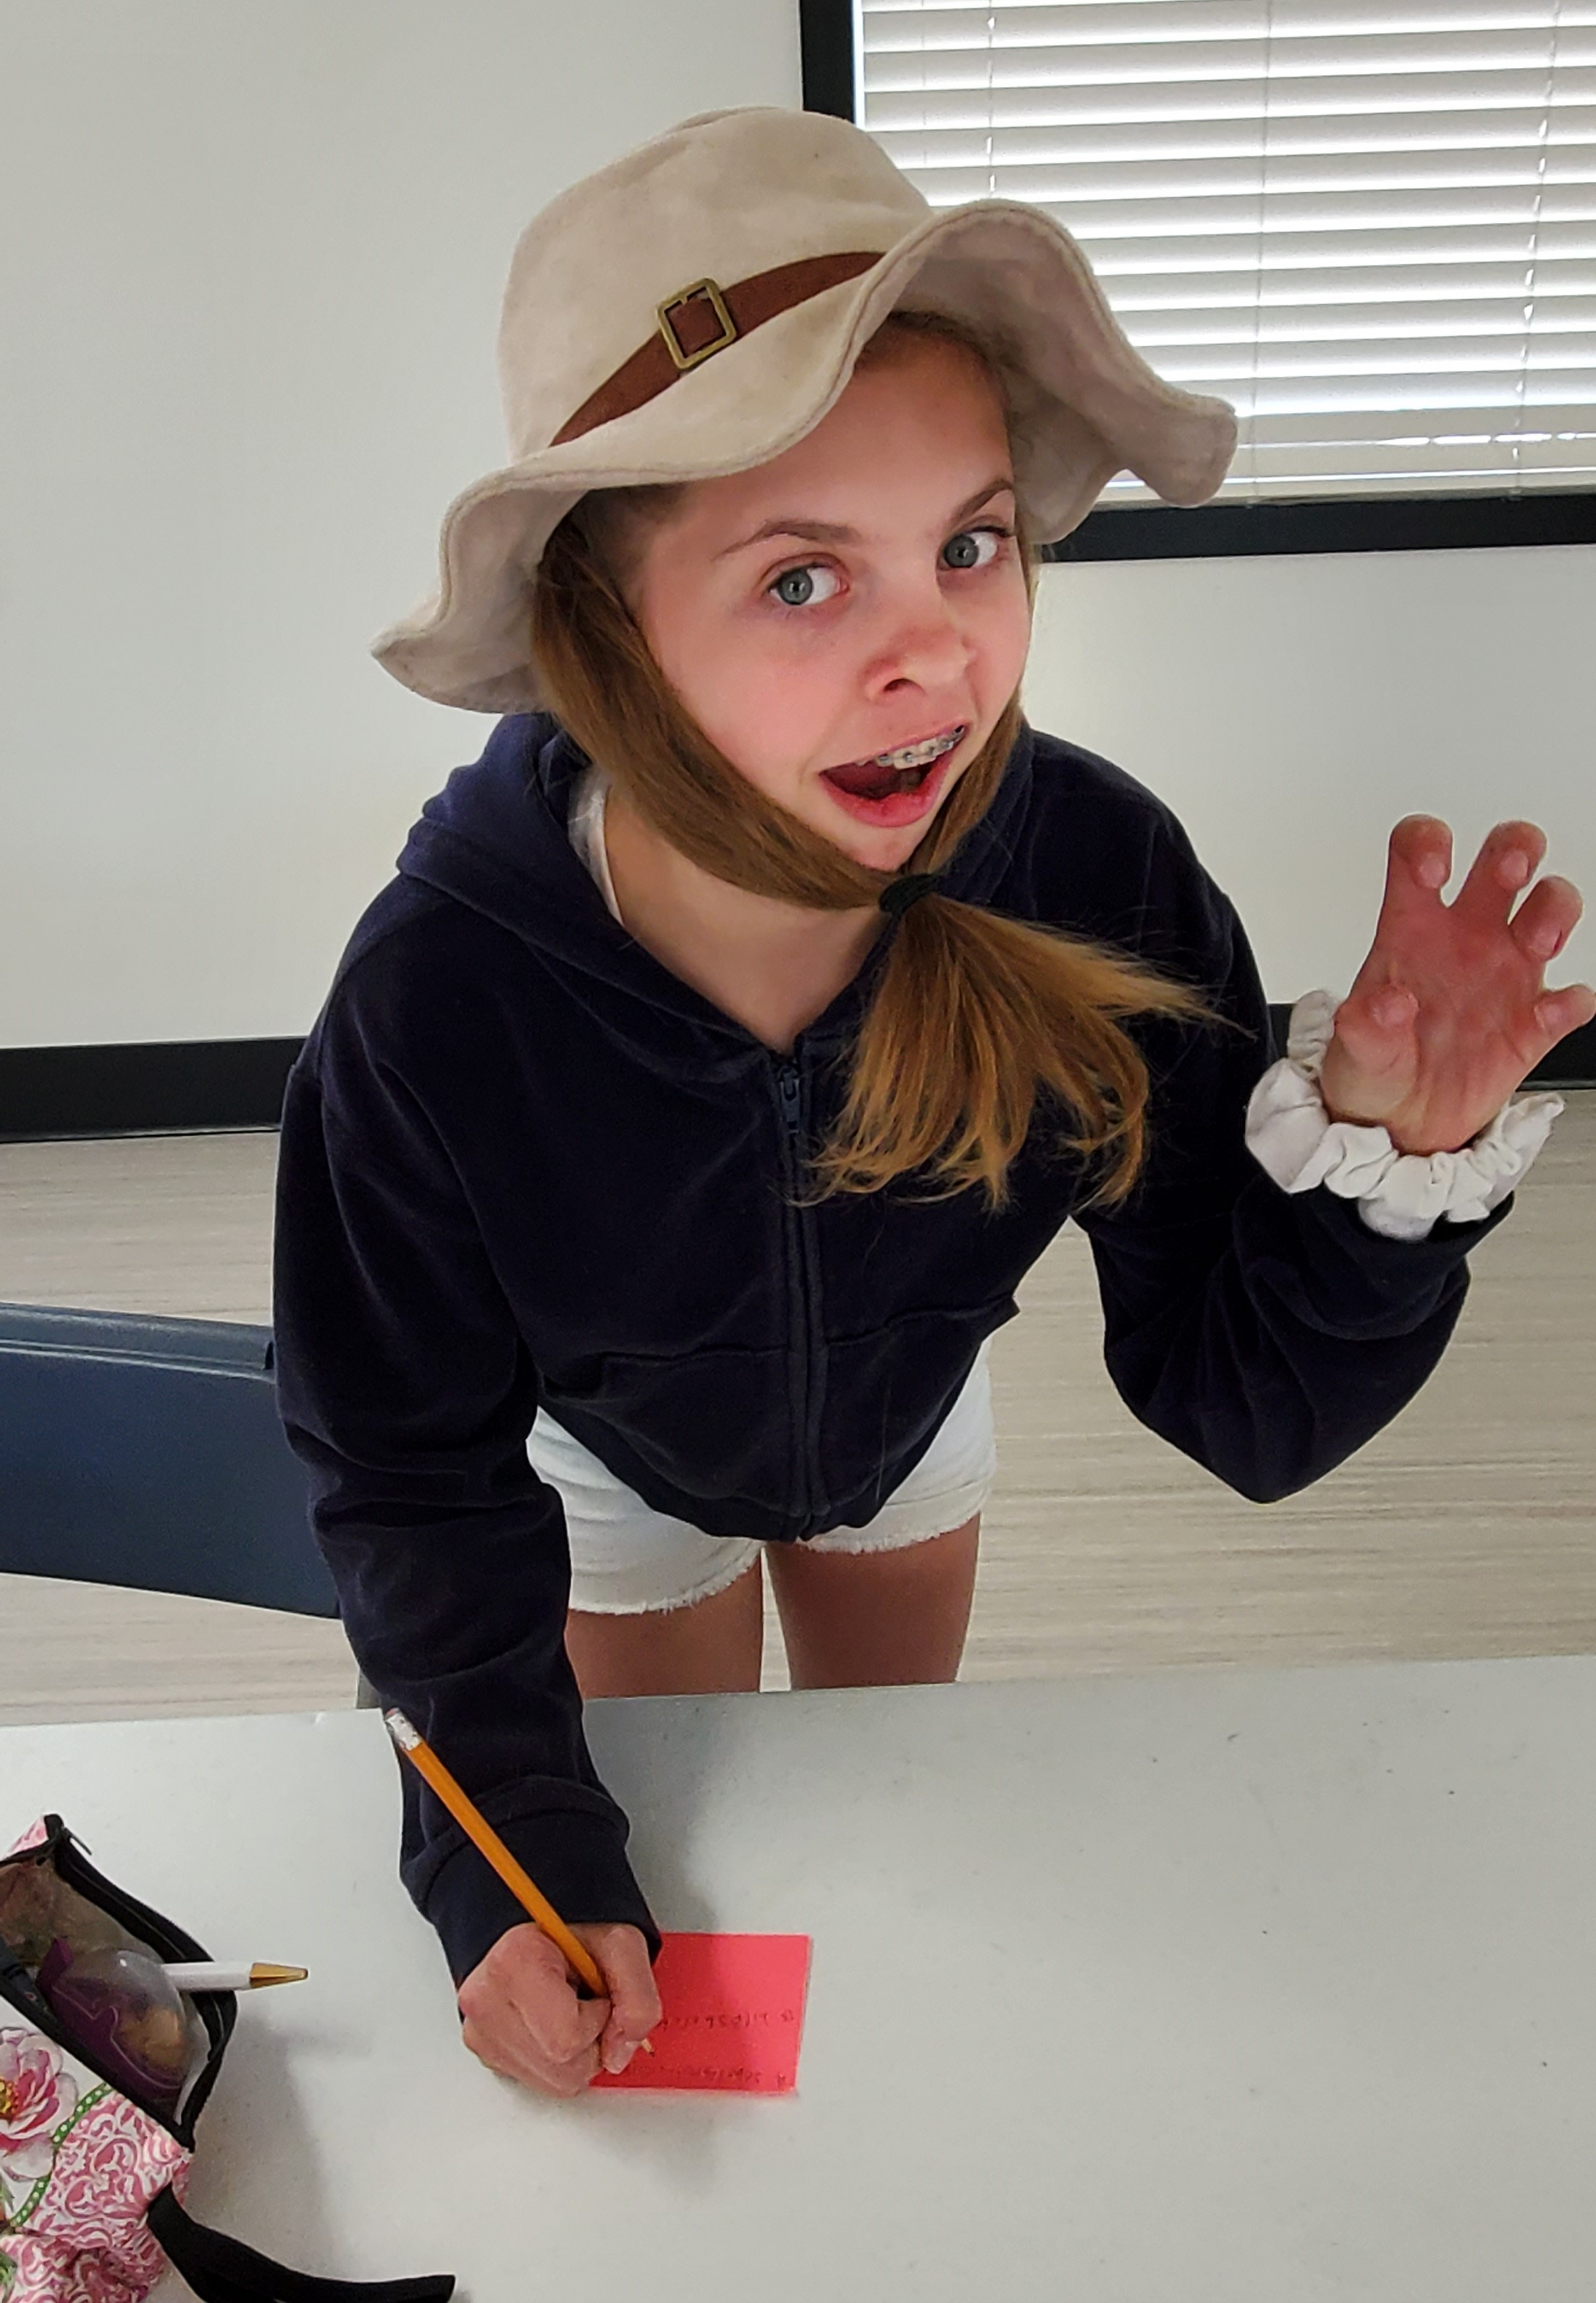
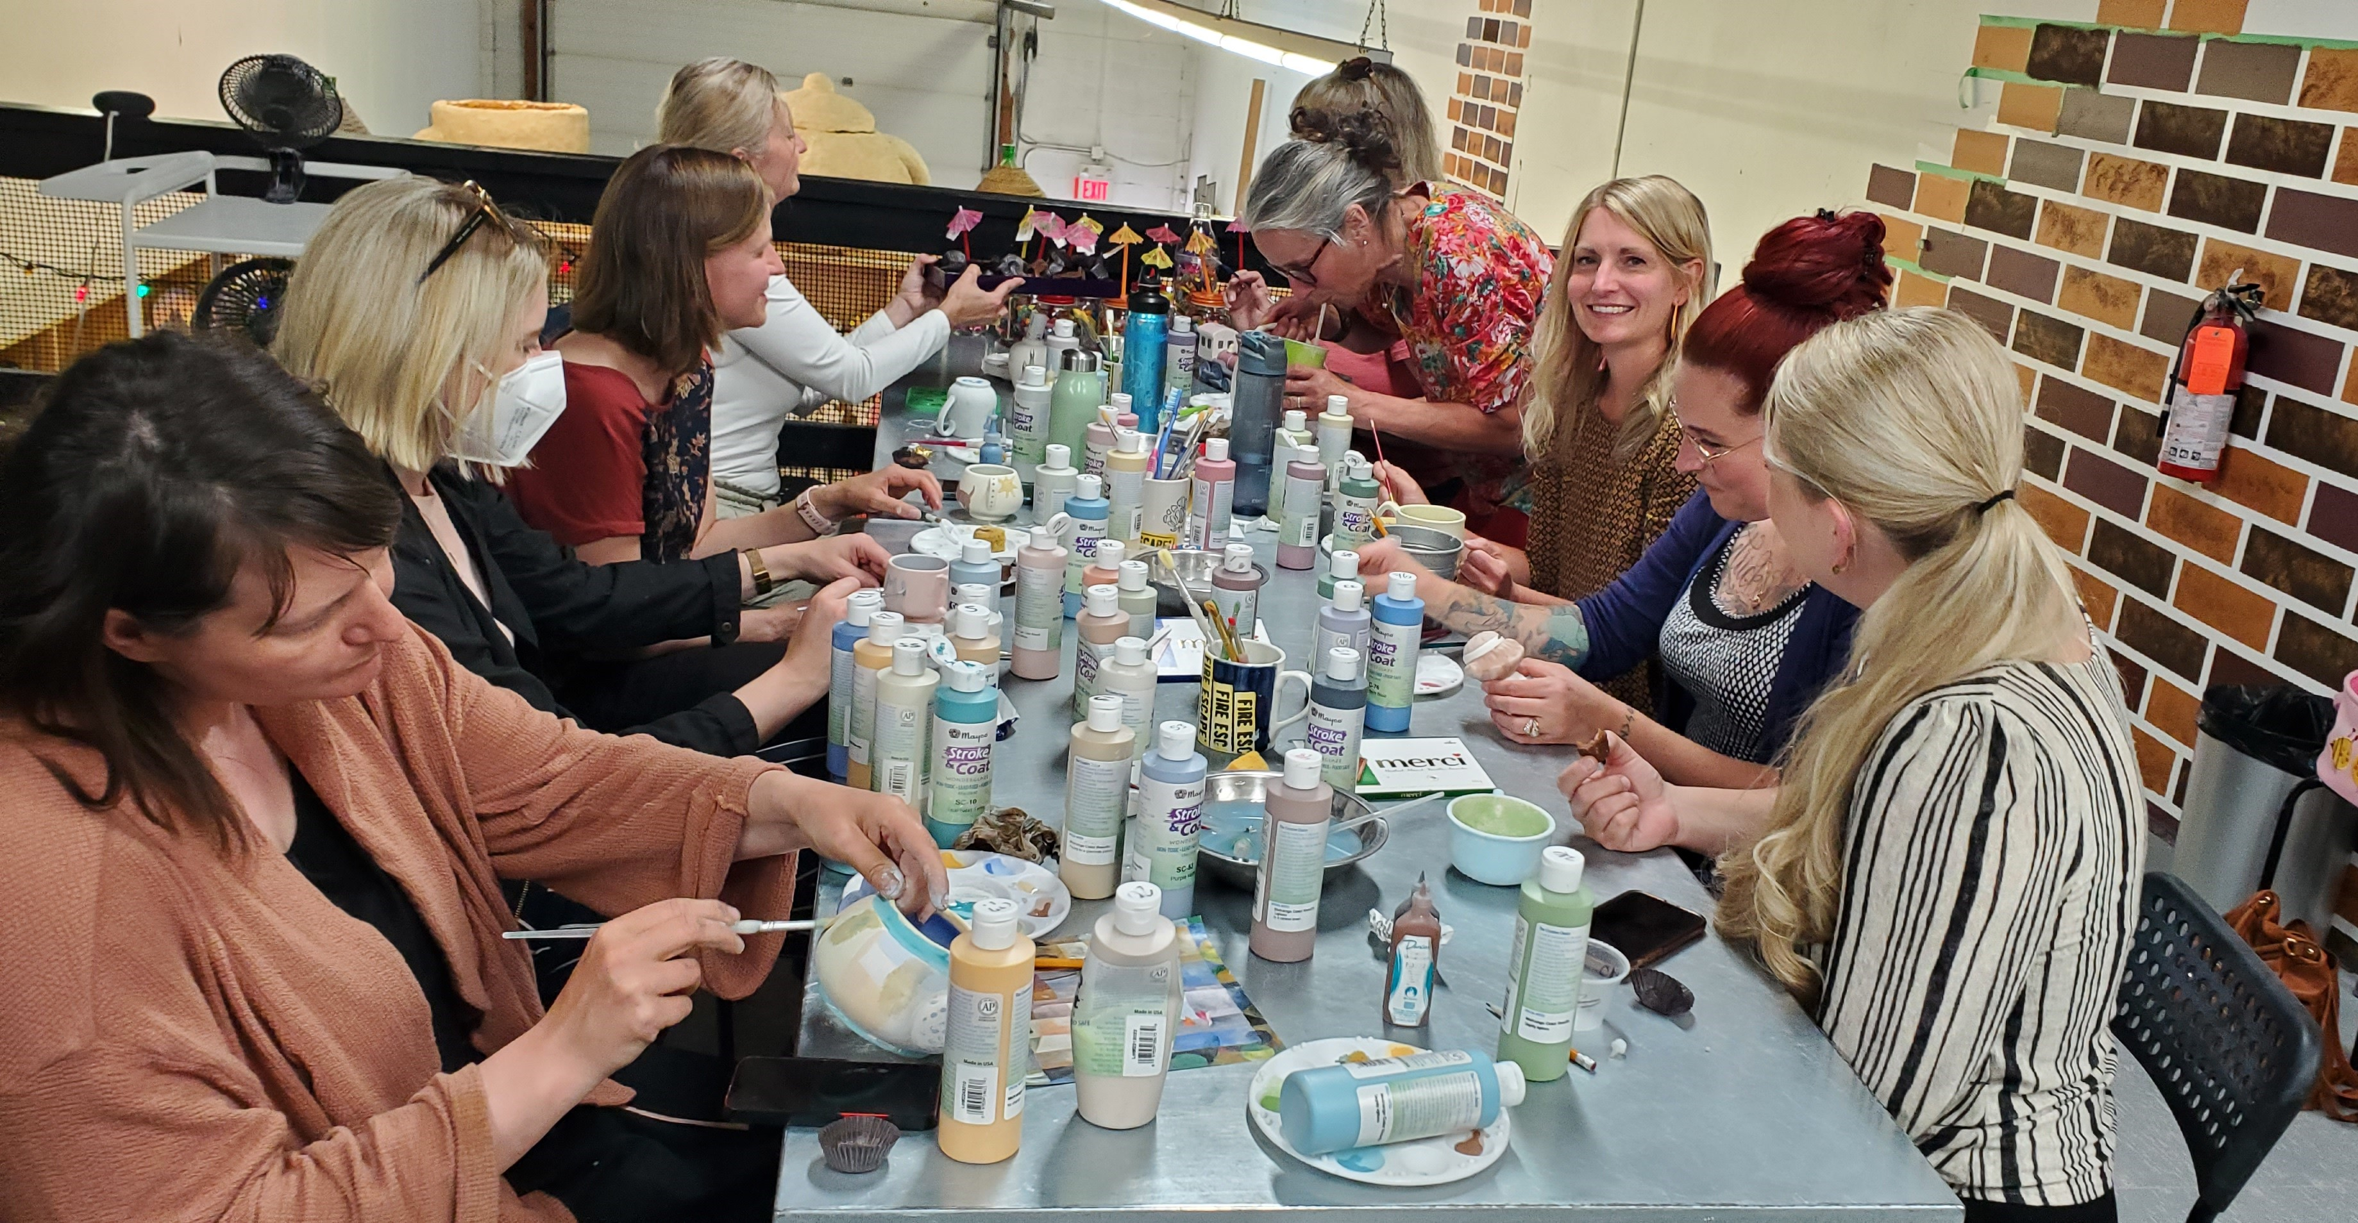
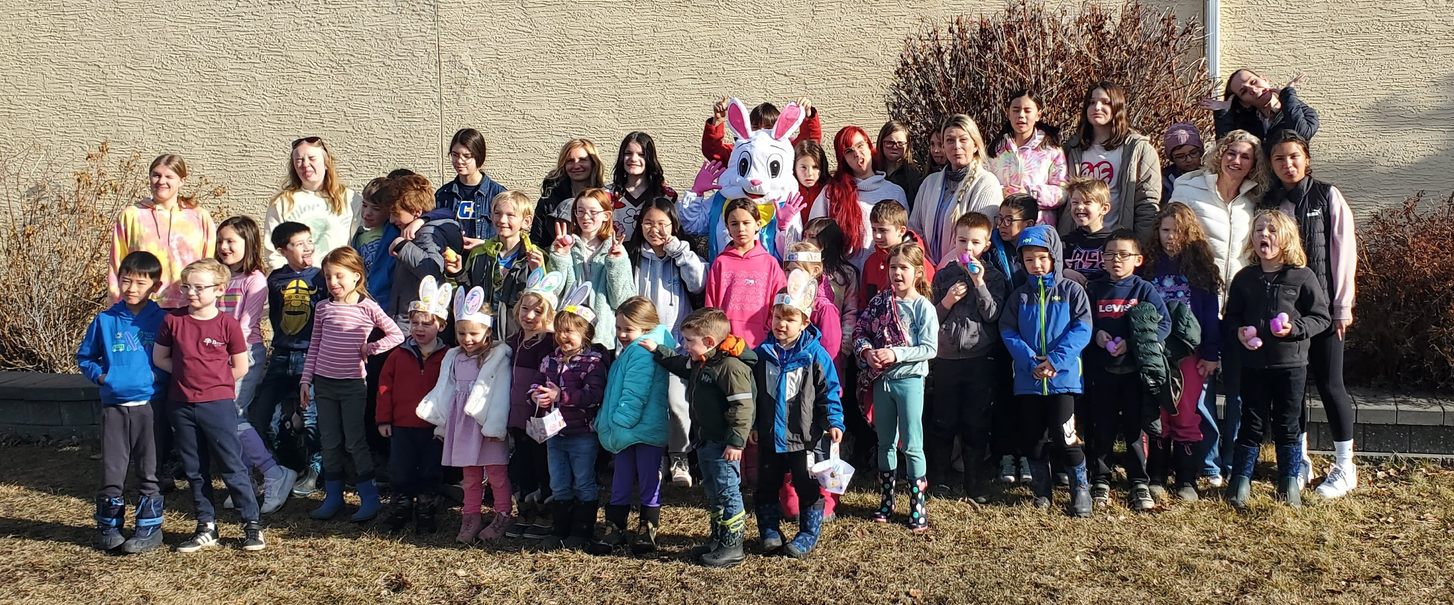
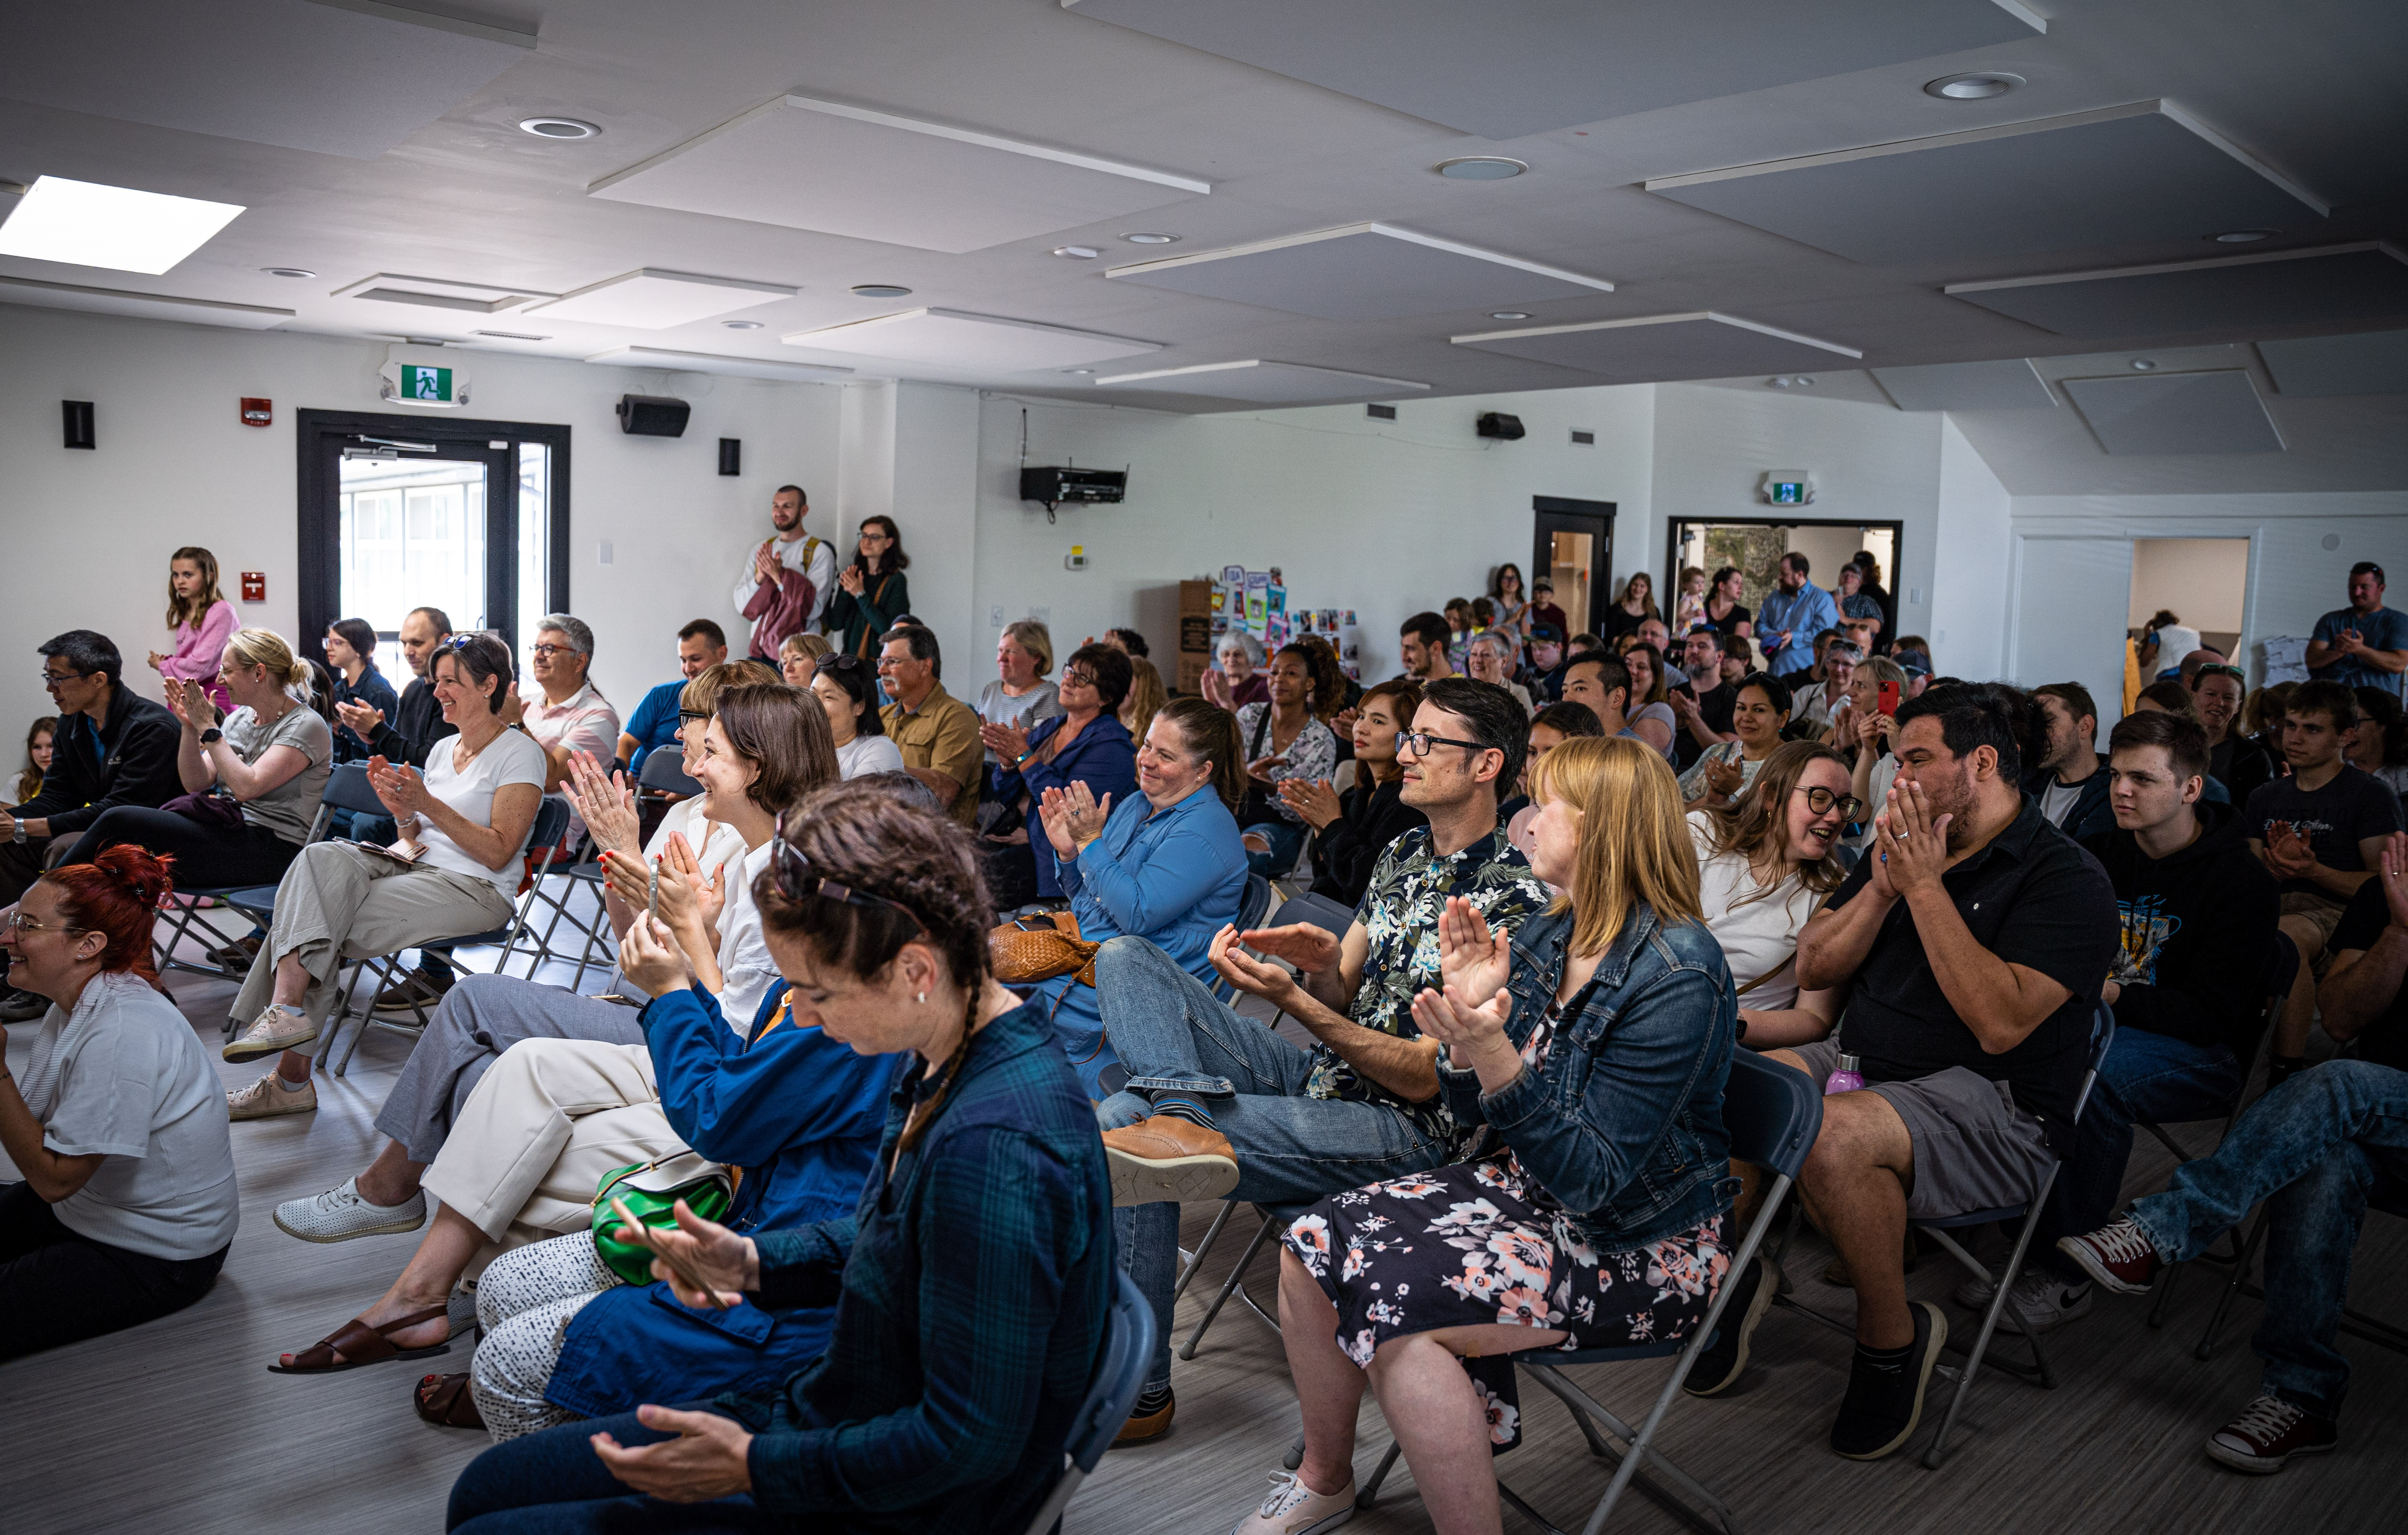
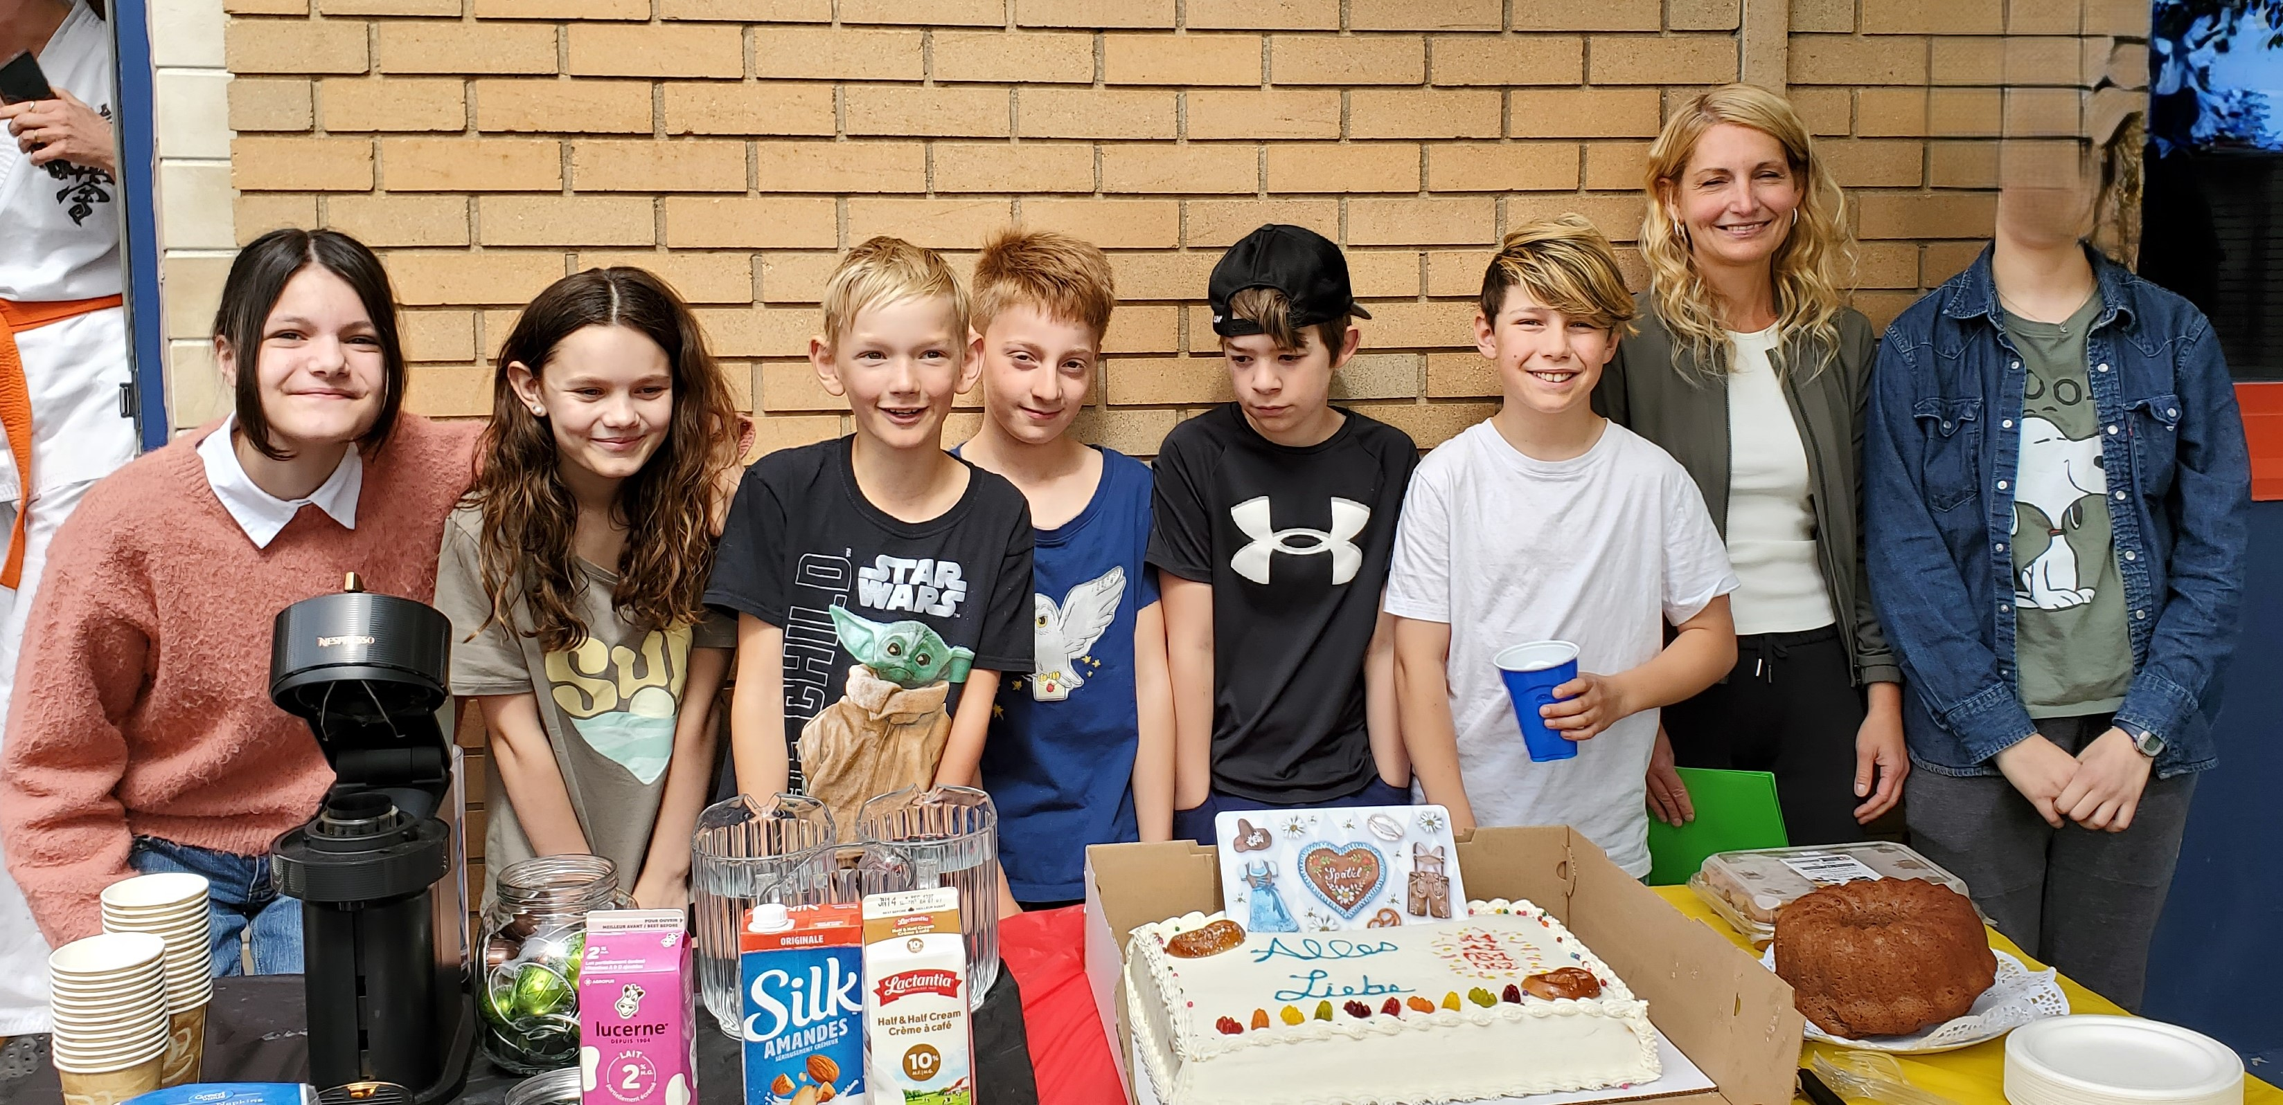
Time to Get Started
Correlation to Culture
Connection to Community
Inspiration
Keep/Delete
Roles and Responsibilities
Partnerships
Notes:
Curriculum is always evolving and not static. Don’t be afraid to review it, make changes, keep the good stuff and be willing to change it up. It’s not a one size fits all, so no matter how you look at it ask yourself is it growing? Have we involved key stake holders. Do we want to pursue accreditation and remind ourselves it’s a process. Use the talent in your community and among your staff as they have a lot to contribute, but also need opportunities to have professional development. At CGLS we have monthly staff meetings and a chance to touch base. We have revamped our grading formats and have regular input in how they are developed. It is a collaborative method and it is a form of reporting assessments and outcomes. Partner with those in your community

Slide 9
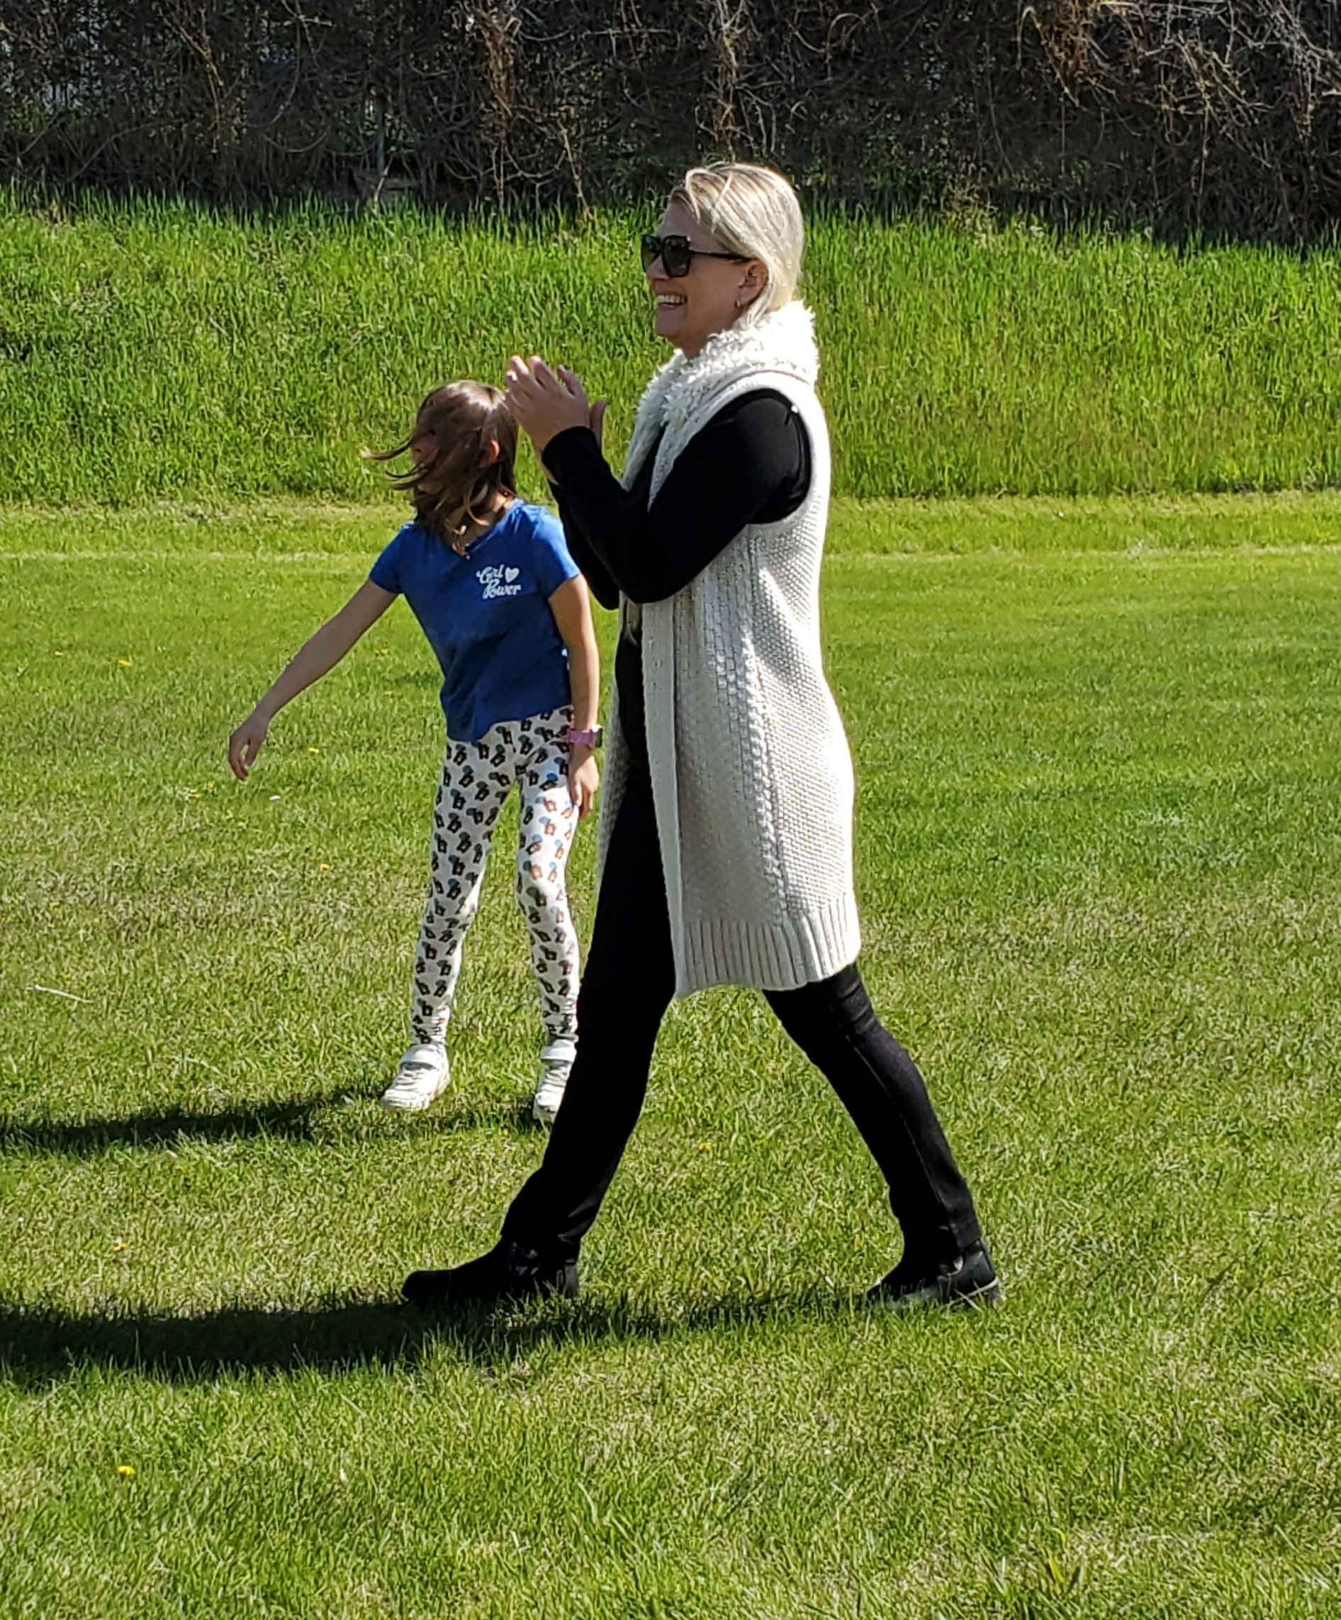
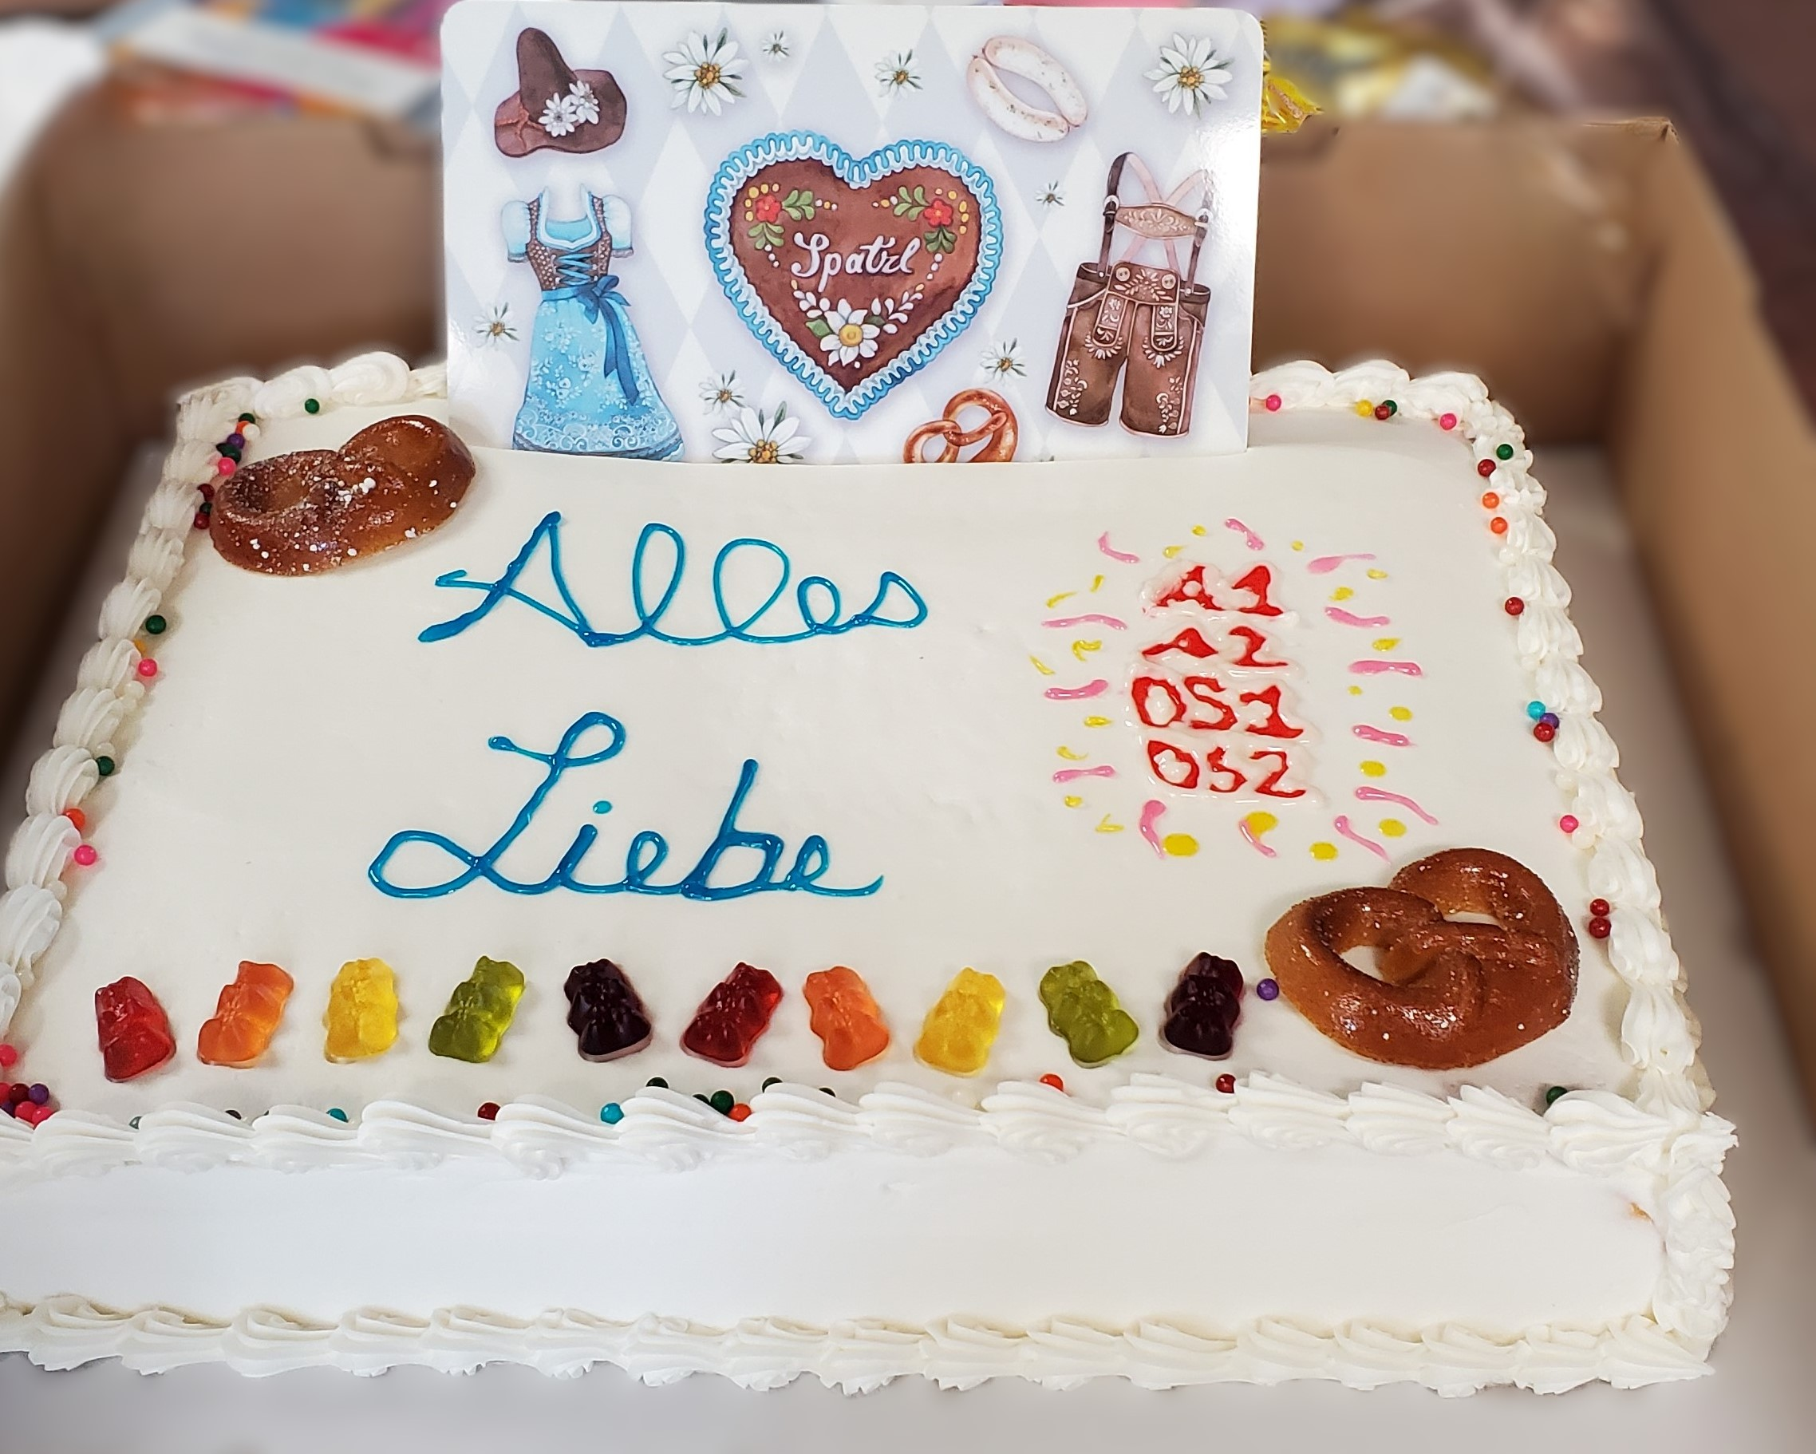
You Got This
Stay current and provide information on credit programs available to older students.
Keep the integrity of developed materials while adapting to the needs of your students.
Allow time to adjust to curriculum and assessment changes.

Slide 10
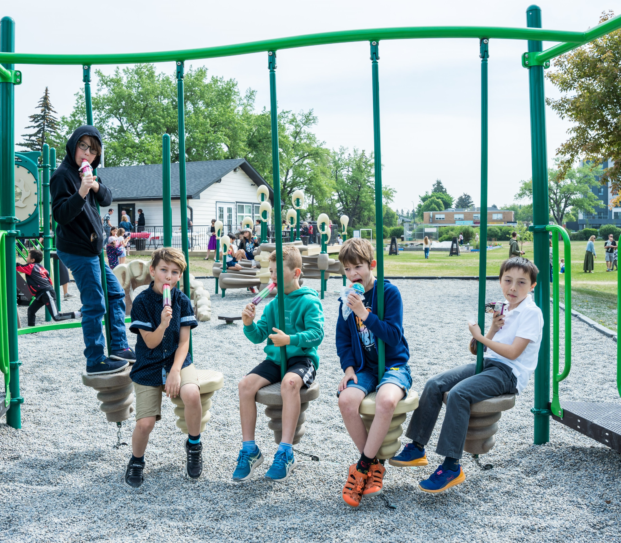
Questions?

Slide 11
Handouts
Alberta Education credit information

